Slide 1
Alkiviadis Filis
confidential
August 2018
Regional Sales Manager
ABB-EPIS

Slide 2
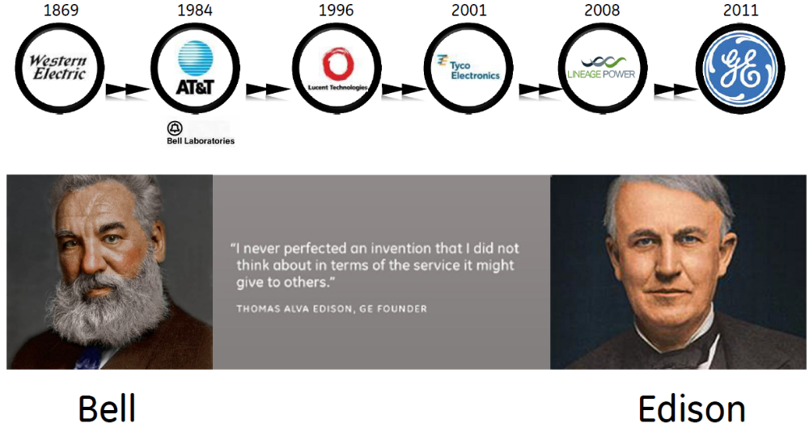

ABB-EPIS History
2018

Slide 3
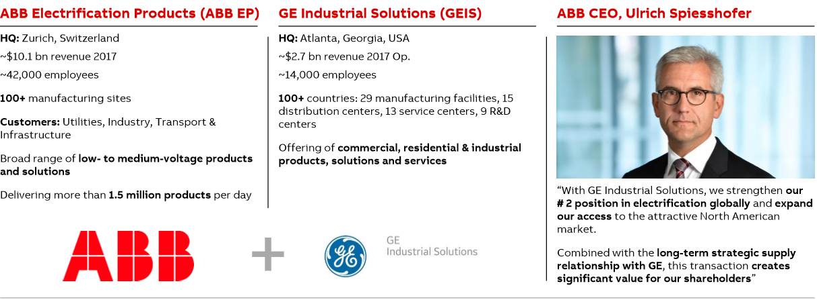
ABB and GEIS have joined forces to unlock value as the partner of choice

Slide 4
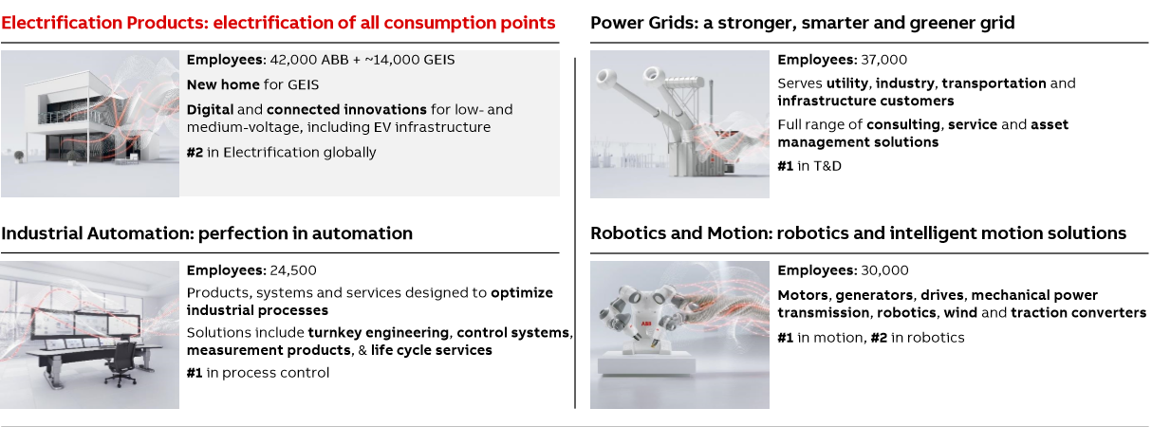
Four market-leading entrepreneurial divisions
ABB division overview
GEIS is now EPIS, a part of ABB Electrification Products division

Slide 5
AC/DC Power Supplies

Slide 6
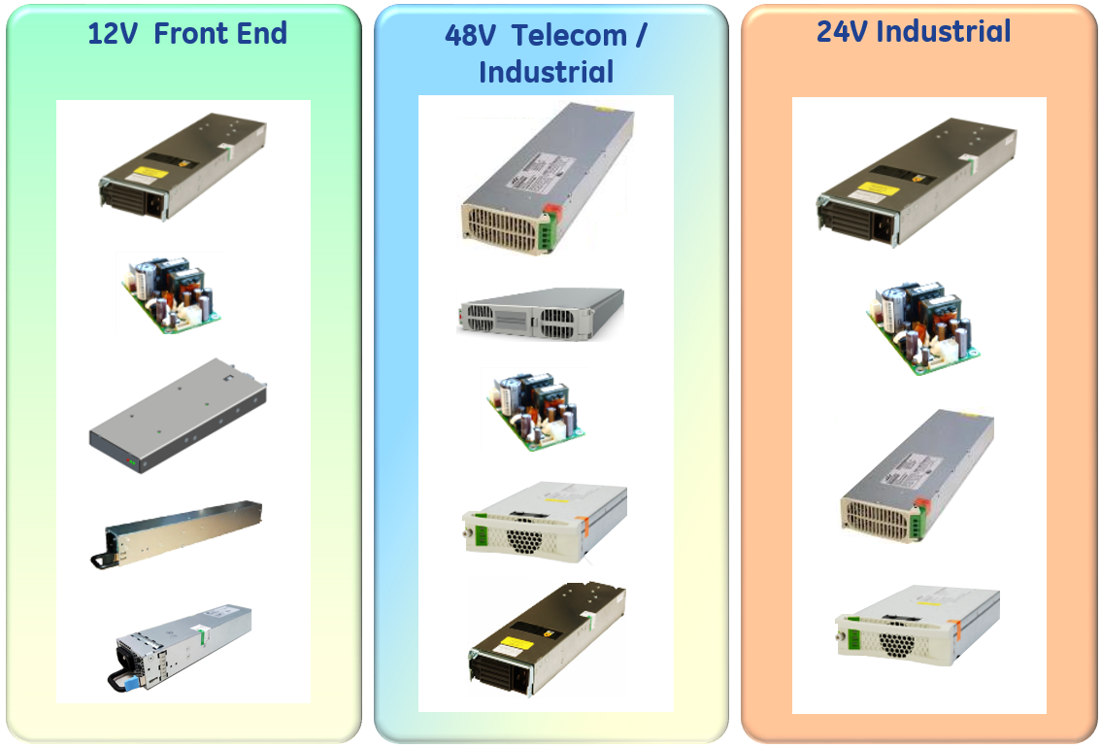
AC/DC Solutions by output voltage
150W – 12.5KW
CAR
CP
CAR
CLP
GP100
CLP
CCR
CLP
EP
CP
SLP
MPR
EP
MPR

Slide 7

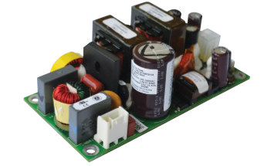

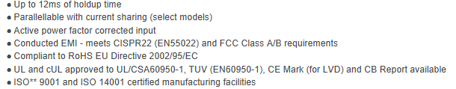
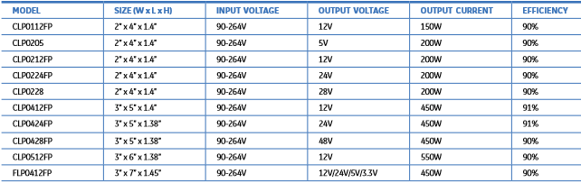
CLP Series – Open Frame 150W – 550 W; 5V,12,24,28 and 48V out

Slide 8
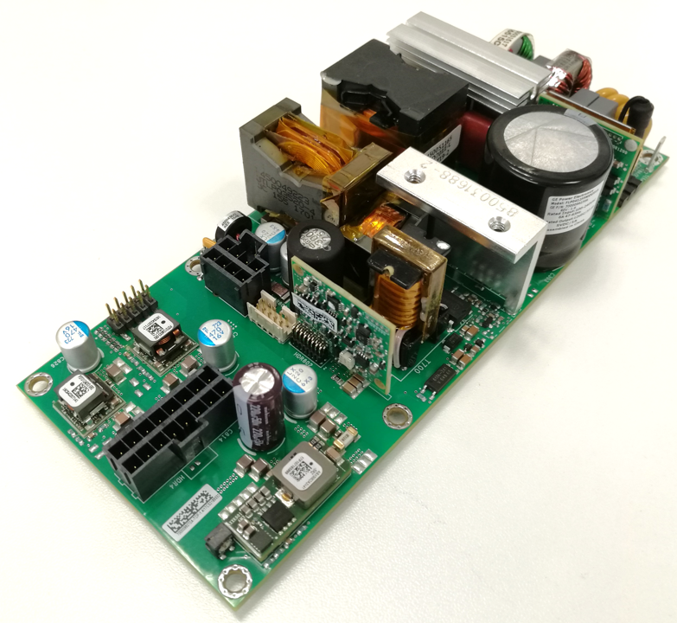
FLP0412
90 to 264VAC Input; 12Vdc output, 450W
Applications: Wide use, Industrial, Test & Measurement, etc.
Key Specifications and Features
Up to 450W out over 90-264VAC input,
12V main, + 3 configurable outputs from GE POL’s!
Class B Conducted EMI
IEC61000-4-5, Level 4 Surge Immunity (2kV/4kV)
3 x 7 x 1.4 “
Wide operating temperature range (-40 to 85ºC)
Safety: CSA, UL, VDE
3” x 7”
Package
10pin digital header
Trim pot for each of the other 3 voltages
(12V Main) + (Boost 28V) + (PDT012) + (PDT012)
Tunable loop set for nominal use.
Distribution version will have pots for voltage adjust
Direct customer version with resistor programming
10pin header for use with the dongle, just for digital POLs
320W capable in conduction-cooled operation
OCP/OTP/OVProtection
Paralleling with main output only
Allows for about 300 combinations
1.8V
2.5V
12V
24V

Slide 9
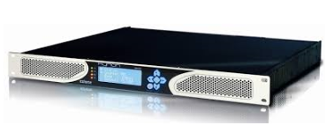
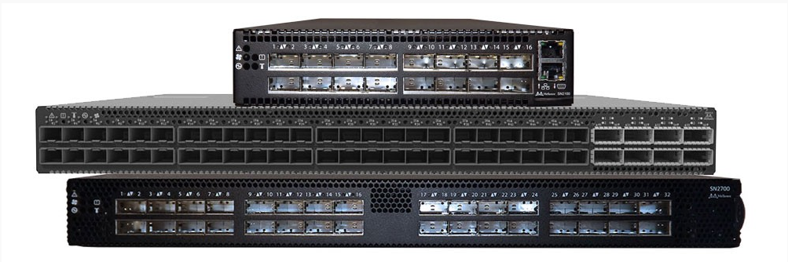

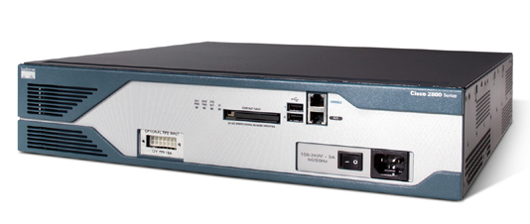

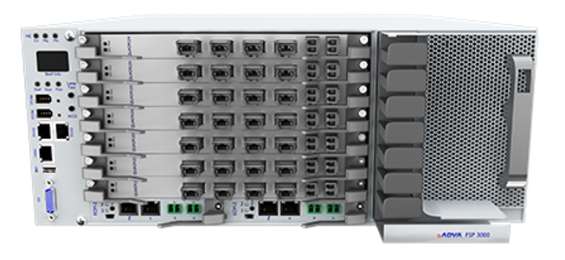
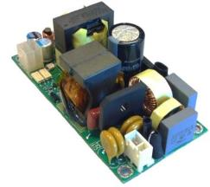
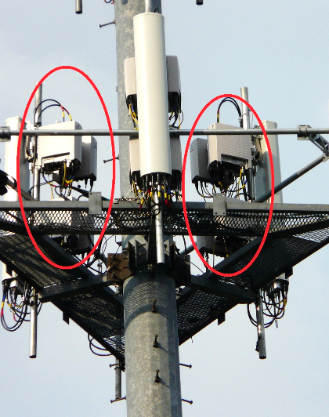
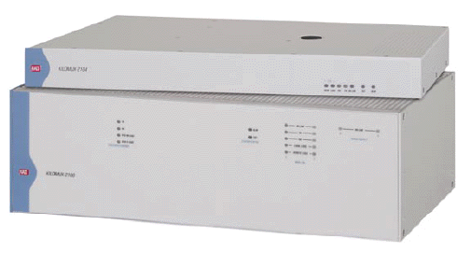
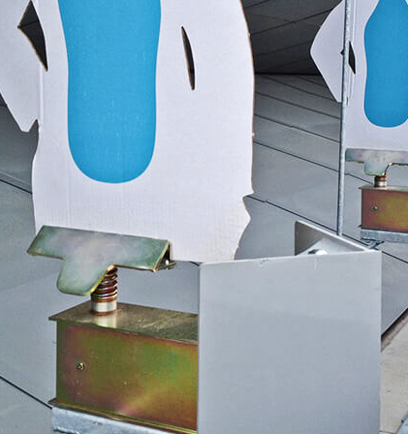
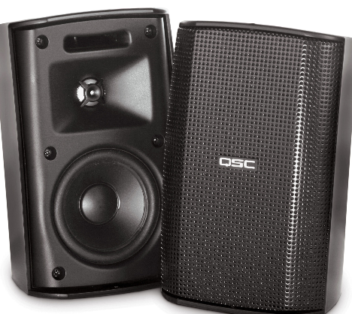
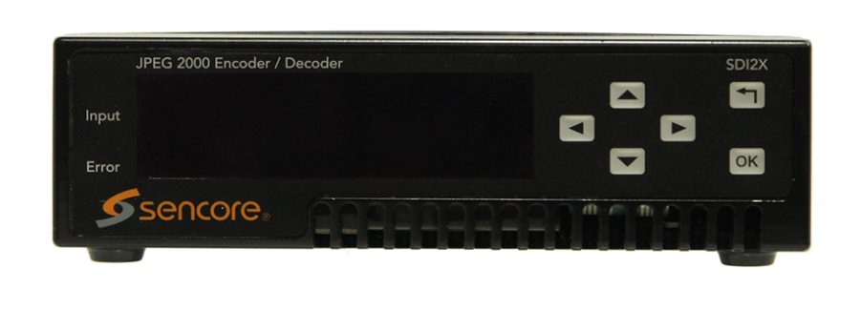



CLP Series – Open Frame 150W – 550 W; 5V,12,24,28 and 48V out
Video Servers
Ethernet Switch Systems
Satellite TV equipment
Network Routers
Laser Equipment
Optical Networking &
Long Haul transmission
CLP Series,
Outdoor Sealed
Enclosures
Carrier Grade Ethernet
Video Delivery / Monitoring
Shooting Range
Equipment
Professional Audio
Broadcasting
LED signage / lighting
Test and Measurement

Slide 10
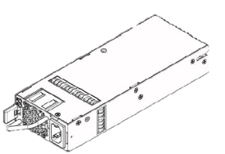
MPR series
Features:
Auto Fan speed control
Universal AC input
Stby output voltage (5V or 3.3V)
Remote on/off
Current Limit Protection
Short Circuit Protection
Over Voltage Protection
Over Temp Protection
LED indicators
I2C (PMBus) dig status and control
Performance:
High power density
High Efficiency, Flat eff curve
High reliability
Output tightly regulated
Hold up time ~ 12mS
Parallellable with current sharing
MPR1848
In Development and subject to change
Model | Power Rating | Output Voltage | Dimensions L x W x H | AC Input | Efficiency rating goal | Schedule goal for RTM
MPR0854FP | 800W | 54V | 8.69” x 3.4” x 1.57” | Front | Gold | released
MPR1348FP | 1300W | 48V | 14.78” x 3.4” x 1.6” | Rear | Gold | released
MPR1848FP | 1800W | 48V | 11.52” x 5.56” x 1.6” | Front | Platinum | released
MPR0712TE | 750W | 12V | 2.15” x 9.0” x 1.57” | Front | Platinum | Nov 2017
MidPower Rectifiers!!

Slide 11
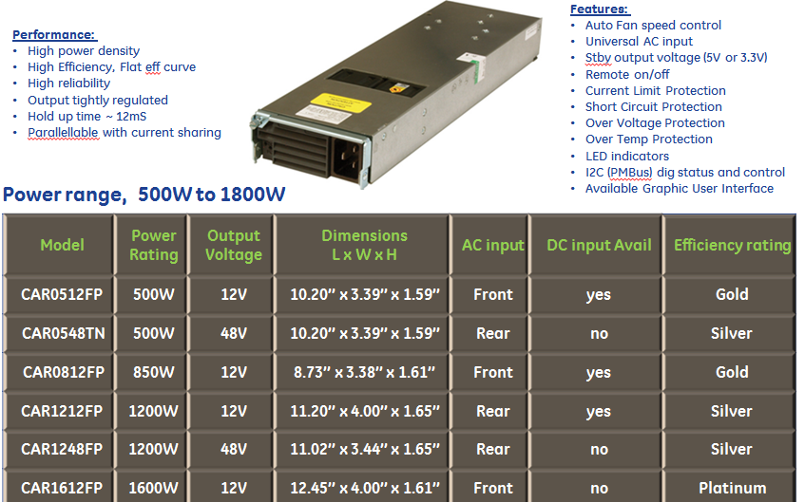
CAR Series 500 to 1800W

Slide 12
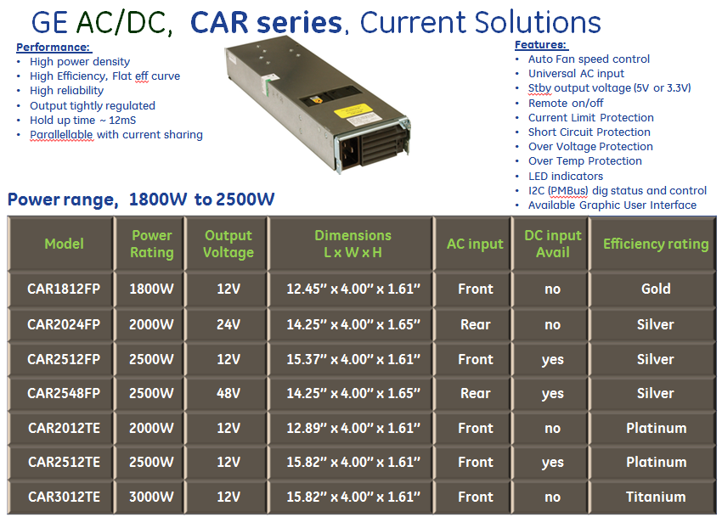
CAR Series 1800W to 2500W

Slide 13
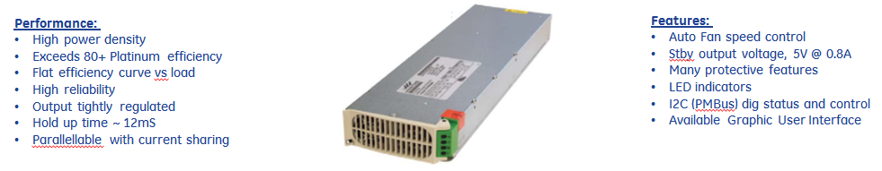
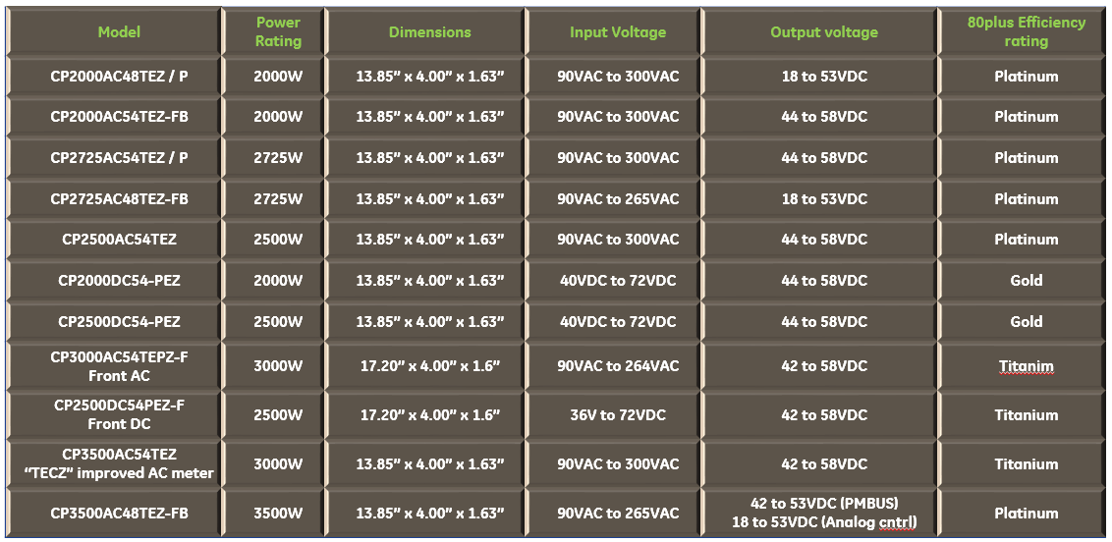
CP Series – Compact Power Line High Efficiency 1U Rectifier

Slide 14
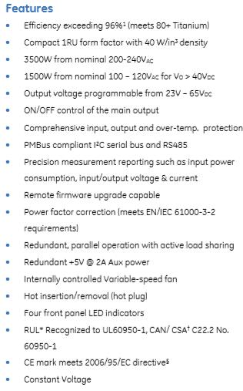
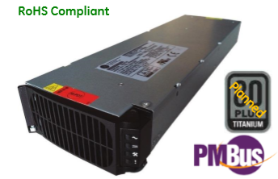
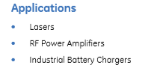
CP3500AC65TEZ
Input: 100-240 Vac; 3500W capable; 65 Vdc @ 3500W; 5 Vdc @ 10W
ABB Embedded Power has developed a 3.5 kilowatt (kW), 65 V power supply unit to drive NXP transistors of the MRFX Series. Our collaboration with NXP will make possible a new generation of robust RF systems that enable higher power applications reliably delivering high efficiency, flexibility, and control for faster development time.
Here is the PR from NXP on their 65V LDMOS Technology and introduction of ABB’s CP3500AC65.
http://media.nxp.com/phoenix.zhtml?c=254228&p=irol-newsArticle&ID=2368963

Slide 15




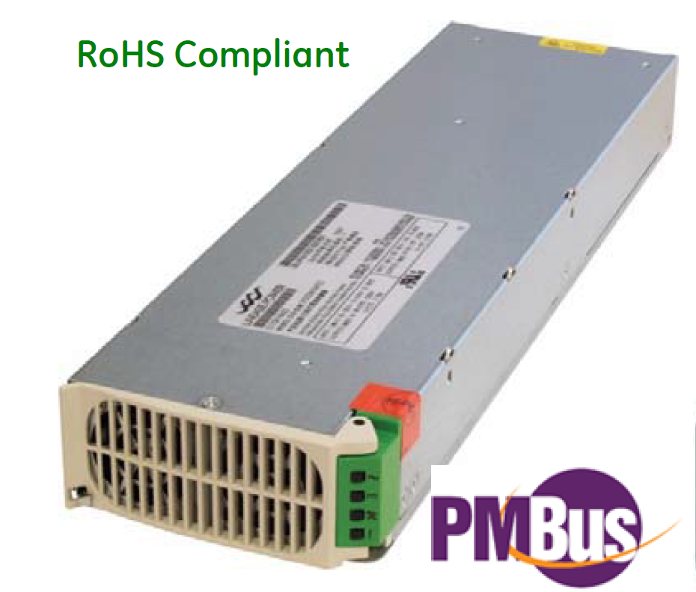
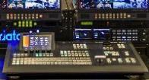

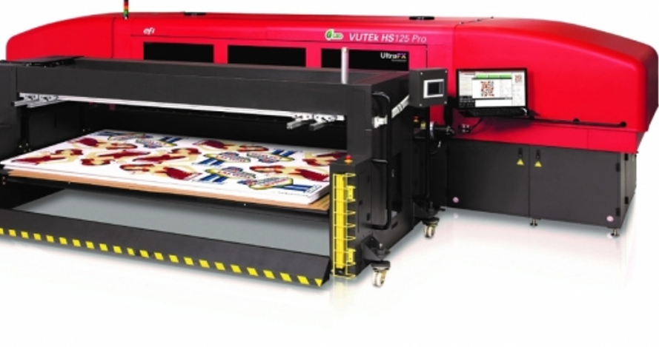
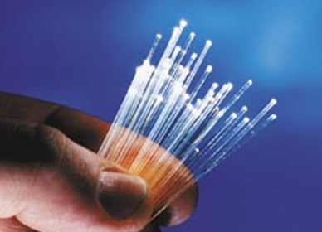

CP Series - Markets beeing served
Laser Equipment
Video Servers
Satellite Technology
Super Computers
Video Editing Equipment
Telecomm
Large Format Printing
Optical Transmission
Data Centers
Broadcasting

Slide 16
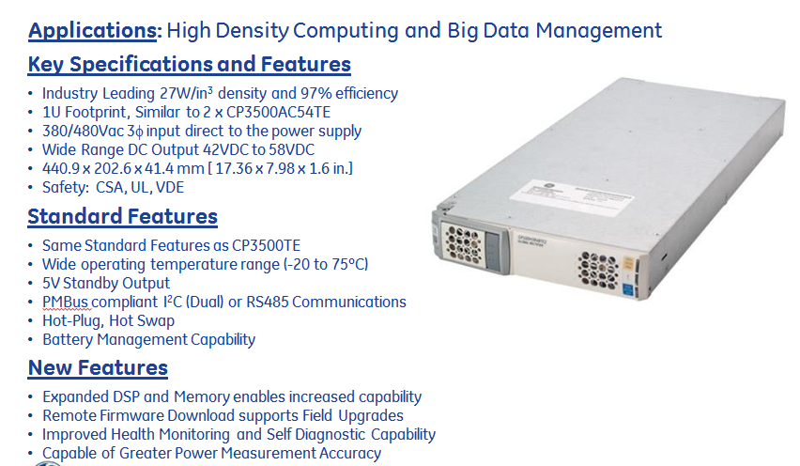

GP100 Three Phase
380VAC or 480VAC 3 Phase Input; 48Vdc output, 6KW
ABB Embedded Power Confidential
GE Embedded Solutions Confidential

Slide 17
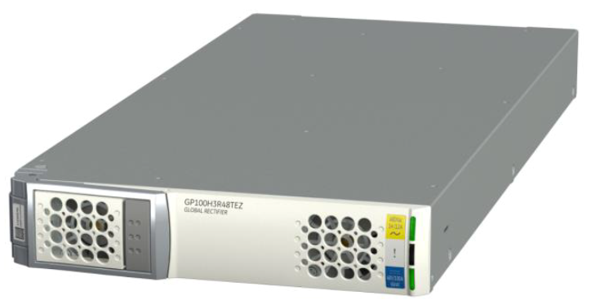
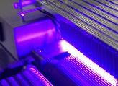
GP Series- Markets beeing served
Telecomm
Laser Equipment
Data Centers
LED UV Curing equipment
Large Format Printing

Slide 18
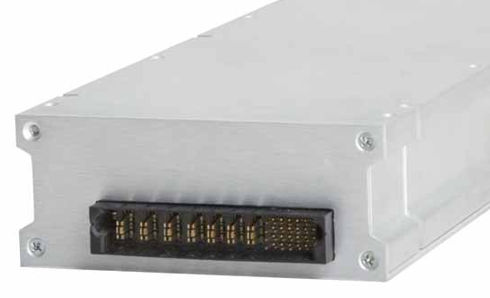
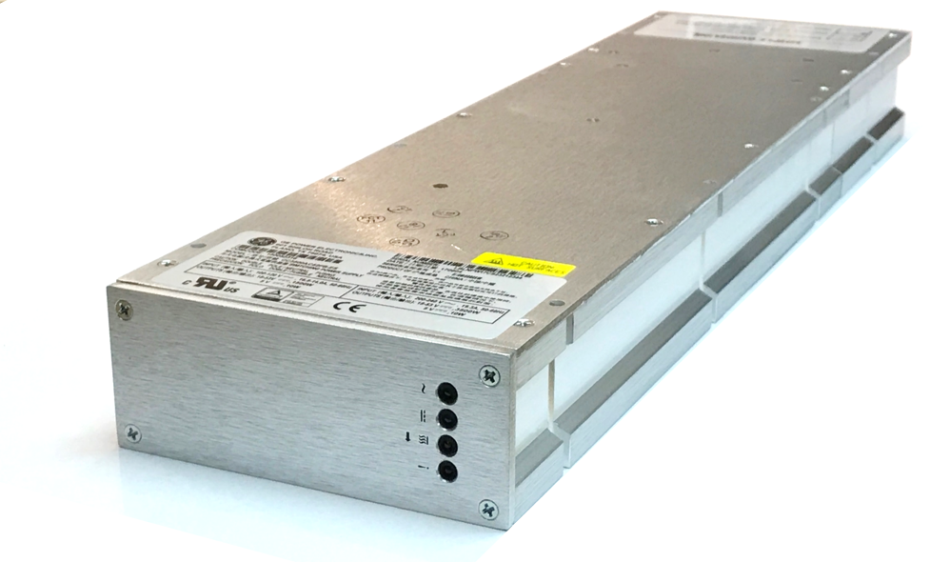

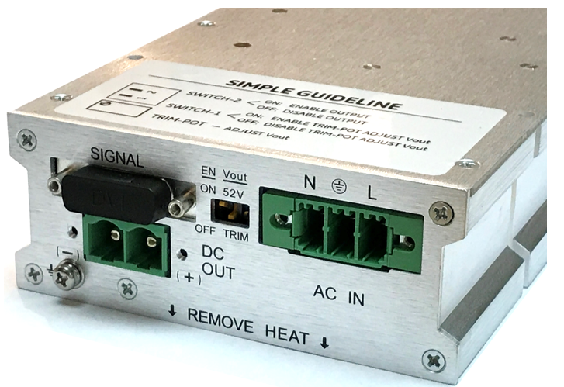
CC3500FB Conduction Cooled Industrial
90 to 265VAC Input; 48Vdc output, 3500W
Key Specifications and Features
Fanless Operation
Industry Leading 39W/in³ density (CP3500TE)
Similar size/footprint as CP3500TE
Blind Mate, 325.45 x 118 x 47.5 mm (12.81 x 4.64 x 1.87 in)
Connector, 434.5 x 118 x 47.5 mm (17.11 x 4.64 x 1.87 in)
Wide Range AC input 90-120/200-240-265VAC
Standard DC Output 52VDC
Programmable from 18VDC to 53VDC
Safety: CSA, UL
Applications: General Purpose, Industrial, Broadcast, Networking
Blind Mate Model
CC3500AC52FB
150052312
Standard Features
3500W from Nominal 200-240VAC @ 50C
1500W from Nominal 100-120VAC @50C
Wide operating temperature range (-40 to 75ºC)
Optional Phoenix Screw Terminal Connector
Optional C19 AC, Phoenix Screw Connector DC
5V Standby Output
PMBus (Dual) Available
Hot-Plug Connector Option
C19 AC, & Screw Terminal DC Model
CC3500AC52FB-EC
150052315
Screw Terminal AC & DC Model
CC3500AC52FB-ES
150052316

Slide 19
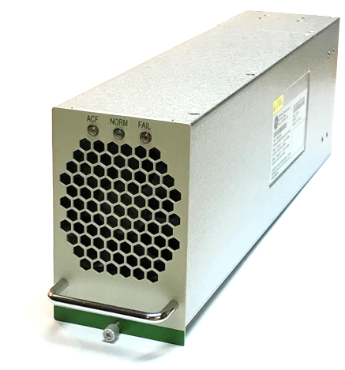
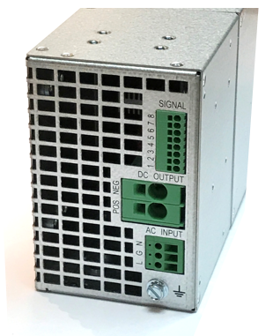
Resilient 3000 General Purpose
90 to 300VAC Input; 48Vdc output, 3000W
Key Specifications and Features
EP3000AC48IN
Heavy Duty, Air Cooled, Universal Surface Mount
Conformal Coated for Dust and Humidity
Convenient Two-Piece Phoenix Screw Terminal Wiring Connectors
95% Efficiency
388.8 x 132.5 x 84 mm (15.27 x 5.22 x 3.31 in)
AC Input Range 90-290VAC
Standard DC Output 52VDC
Output Power Range 42VDC to 58VDC
>300k hours MTBF calculated
Safety: UL Recognition
Standard Features
3000W from Nominal 176-300VAC @ 50C
1320W to 3000 from 90-176VAC @50C
Wide operating temperature range (-10 to 70ºC)
RS485 Communications Available

Slide 20
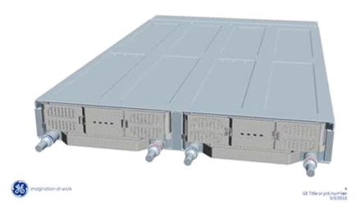
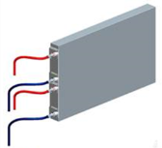
CC12500H3R380TEZ Rectifier
380VAC or 480VAC 3Φ Input; 380VDC output, 12.5K
Applications: Industrial, Laser industry, high density computing, big data
Key Specifications,
3-phase to 380VDC conversion in compact package
12.5KW of power for each module (25KW for 2 per shelf)
Designed for liquid cooling via conduction plate
Allows efficient bussing over long distances
Very high power density, small package size
380VAC or 480VAC 3Φ direct to the power supply
Dimensions of module: 27” x 8” x 2.44”
Greatly improved digital power measurement accuracy
Expanded DSP and Memory supports increased capability
Improved Health Monitoring & Self Diagnostic capability
Remote firmware download enables field upgrades
New rear connector supports future density gains

Slide 21
Isolated DC/DC Converter

Slide 22
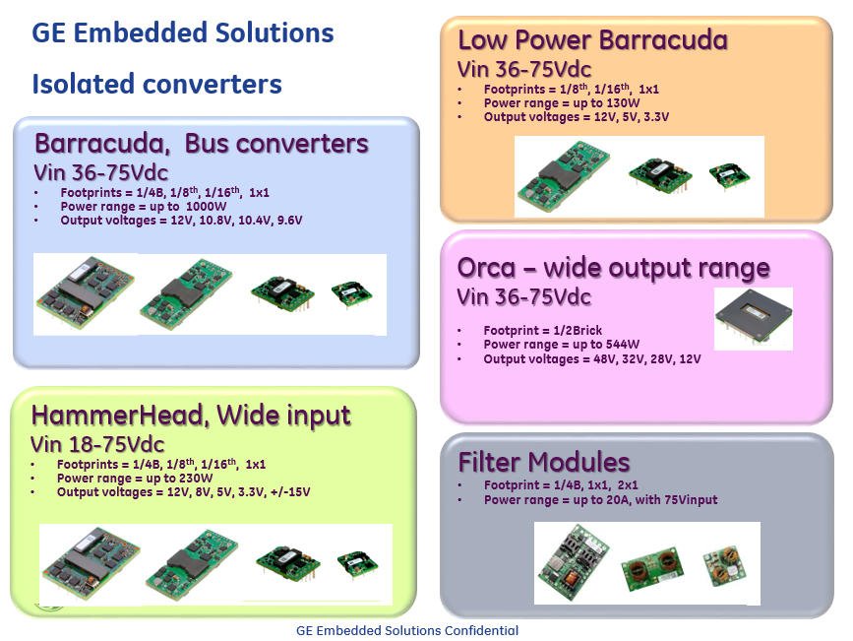
Isolated DC/DC Converters

Slide 23
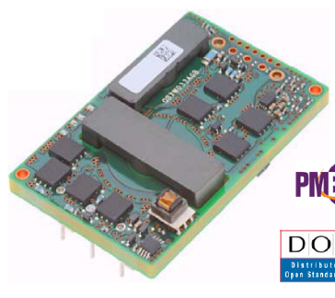
  Isolated Board-Mounted Products (BMP)
  Quarter Bricks
* Available in Digital or Analog versions
Barracuda Series
PIM module
Hammerhead Series
Model | Max Power | Output Voltage | Input Voltage
*QSD(V)W035A0B | 420W | 12V | 36V to 75V
*QSD(V)W042A0Bxx-HZ | 500W | 12V | 36V to 75V
*QBD(V)E067A0Bxx-HZ | 800W | 12V | 40V to 60V
QBVE078A0S10R4 | 810W | 10.4V | 45V to 56V
QBVE094A0S10R7 | 1005W | 10.7V | 45V to 56V
*QBD(V)W033A0B | 400W | 12V | 36V to 75V
*QBD(V)W025A0B | 300W | 12V | 36V to 75V
*QSD(V)W050A0B | 600W | 12V | 36V to 75V
*QBD(V)E055A0B | 660W | 12V | 40 to 60V
*PIM400 Power Entry filter module | 400W | 48V | 36V to 75V
QHHD019A0B | 228W | 12V | 18V to 75V
Link to GE Webpage, high powered Barracuda datasheets:
http://www.geindustrial.com/products/embedded-power/high-power-barracuda
Link to GE Webpage, PIM400 filter module datasheet:
http://www.geindustrial.com/products/embedded-power/atca-pim-modules
Link to GE Webpage, QHHD019 module datasheet:
http://www.geindustrial.com/products/embedded-power/hammerhead
23

Slide 24
Isolated BMP Products – Quarter Bricks
* Available in Digital or Analog versions
Barracuda Series
PIM module
Hammerhead Series
Model | Max Power | Output Voltage | Input Voltage
*QSD(V)W035A0B | 420W | 12V | 36V to 75V
*QSD(V)W042A0Bxx-HZ | 500W | 12V | 36V to 75V
*QBD(V)E067A0Bxx-HZ | 800W | 12V | 40V to 60V
QBVE078A0S10R4 | 810W | 10.4V | 45V to 56V
QBVE094A0S10R7 | 1005W | 10.7V | 45V to 56V
*QBD(V)W033A0B | 400W | 12V | 36V to 75V
*QBD(V)W025A0B | 300W | 12V | 36V to 75V
*QSD(V)W050A0B | 600W | 12V | 36V to 75V
*QBD(V)E055A0B | 660W | 12V | 40 to 60V
*PIM400 Power Entry filter module | 400W | 48V | 36V to 75V
QHHD019A0B | 228W | 12V | 18V to 75V

Slide 25
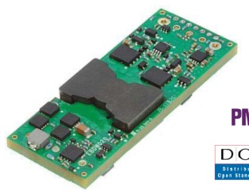
Isolated BMP Products – Eighth Bricks
Stingray
Orca
Model | Max Power | Output Voltage | Max Output Current | Input Voltage
ESTW004A2C | 60W | 15V | 4A | 36V to 75V
ESTW006A0B | 72W | 12V | 6A | 36V to 75V
ESTW010A0A | 50W | 5V | 10A | 36V to 75V
ESTW020A0S6R0 | 120W | 6V | 20A | 36V to 75V
ESTW015A0A | 75W | 5V | 15A | 36V to 75V
ESTW015A0F | 50W | 3.3V | 15A | 36V to 75V
ESTW025A0F | 82.5W | 3.3V | 25A | 36V to 75V
ESTW010A0B | 120W | 12V | 10A | 36V to 75V
ESTW024A0A | 120W | 5V | 24A | 36V to 75V
ESTW036A0F | 120W | 3.3V | 36A | 36V to 75V
ERCW003A6R | 100W | 16 to 35.2V | 3A | 36V to 75V

Slide 26
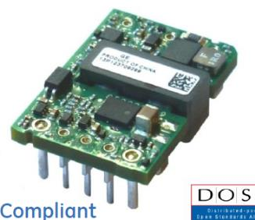
Isolated BMP Products – Sixteenth Bricks
Barracuda Series
Hammerhead Series
Model | Max Power | Output Voltage | Input Voltage | Max Output Current
KBVW006A0B | 72W | 12V | 36V to 75V | 6A
KHHD004A2B | 48W | 12V | 18V to 75V | 4A
KHHD010A0A | 50W | 5V | 18V to 75V | 10A
KHHD015A0F | 50W | 3.3V | 18V to 75V | 15A
KHHD002A5B | 24W | 12V | 18V to 75V | 2A
KHHD004A2S8R0 | 32W | 8V | 18V to 75V | 4A
KHHD006A0A | 30W | 5V | 18V to 75V | 6A
KHHD010A0F | 33W | 3.3V | 18V to 75V | 10A

Slide 27
Isolated BMP Products – Sixteenth Bricks
Stingray
Model | Max Power | Output Voltage | Input Voltage | Max Output Current
KSTW004A2B | 48W | 12V | 36V to 75V | 4A
KSTW010A0A | 50W | 5V | 36V to 75V | 10A
KSTW015A0F | 50W | 3.3V | 36V to 75V | 15A
KSTW002A5B | 24W | 12V | 36V to 75V | 2A
KSTW006A0A | 30W | 5V | 36V to 75V | 6A
KSTW010A0F | 33W | 3.3V | 36V to 75V | 10A
GE Webpage to the StingRay datasheets:
http://www.geindustrial.com/products/embedded-power/low-power-barracuda

Slide 28
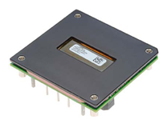
Isolated BMP Products – Half Bricks
Orca
Model | Max Power | Output Voltage | Max Output Current | Input Voltage
JNCW016A0R | 448W | 16V-28V-35.2V | 16A | 36V to 75V
JHVG004A2B4-PHZ | 50W | 12V | 4.2A | 88V to 400V
JRCK017A0S32R0 | 544W | 16V-32V-35.2V | 17A | 36V to 62V
JNCW450R (AC load ver) | 544W | 16V-32V-35.2V | 17A | 36V to 62V
JNC350R | 350W | 28V | 12.5 | 18V to 36V
JNW350R | 350W | 28V | 12.5 | 36V to 75V
JRCW016A0R | 450W | 28V | 16A | 36V to 75V
JRCW450R | 450W | 32V | 14A | 36V to 75V
JRCW450U | 450W | 48V | 9.4A | 36V to 75V
GE Webpage to the Orca datasheets:
http://www.geindustrial.com/products/embedded-power/orca

Slide 29
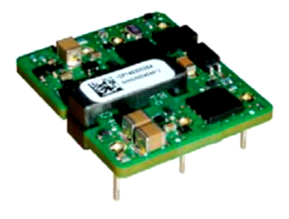
Isolated Products, 1” x 1” footprint
Stingray
Hammerhead Series
Model | Max Power | Output Voltage | Max output current | Input Voltage
SHHD001A3B | 15W | 12V | 1.3A | 18V to 75V
SHHD003A0A | 15W | 5V | 3A | 18V to 75V
SHHD005A0F | 15W | 3.3V | 5A | 18V to 75V
SSTW001A3B | 15W | 12V | 1.3A | 36V to 75V
SSTW003A0A | 15W | 5V | 3A | 36V to 75V
SSTW005A0F | 15W | 3.3V | 5A | 36V to 75V
SHHN000A3CL | 10W | +/-15V | 0.3A, 0.3A | 9V to 36V

Slide 30
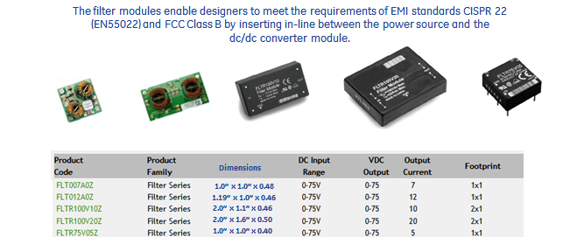
Filter Modules
GE Webpage to filter modules datasheets:
http://www.geindustrial.com/products/embedded-power/filter-modules

Slide 31
Point of Loads

Slide 32
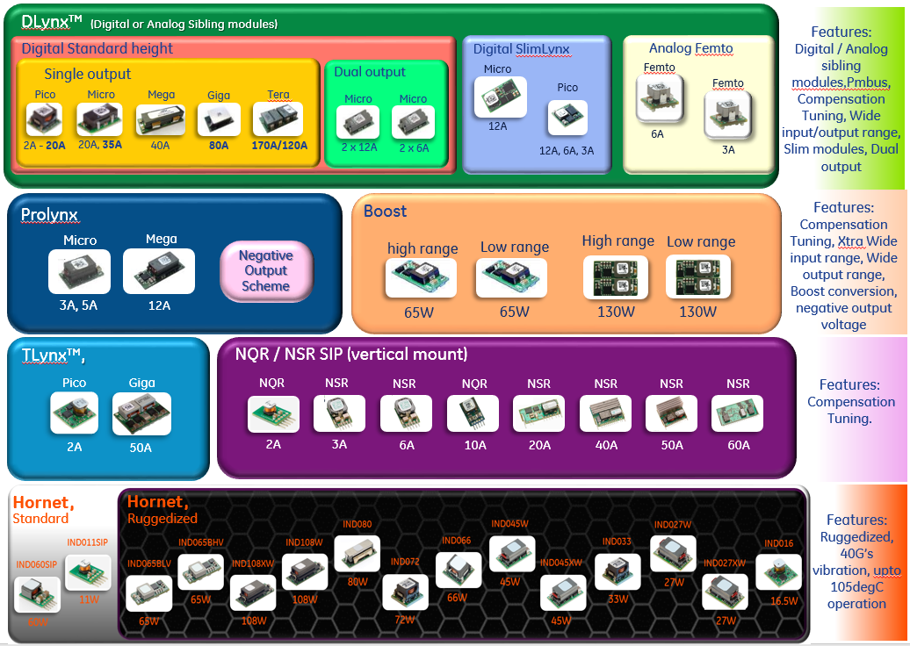
ABB Embedded Power, Non-Isolated Families

Slide 33
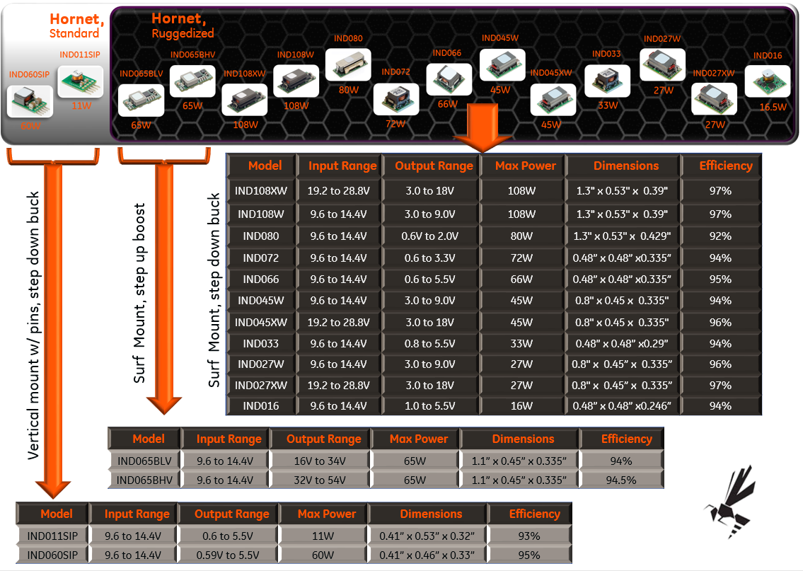
Hornet Industrial Series, General Spec

Slide 34
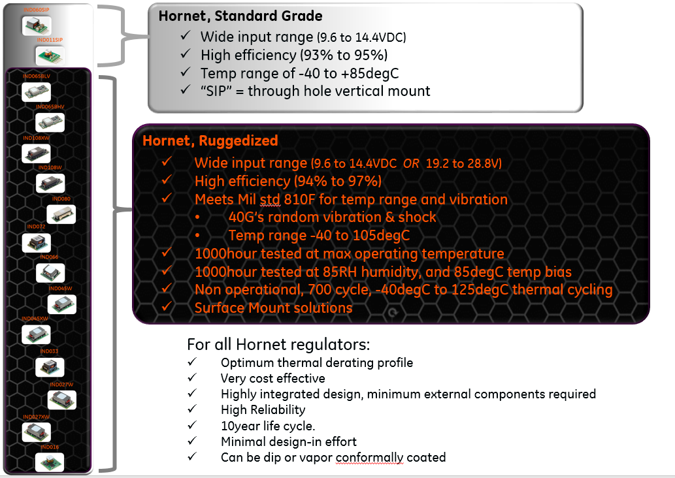
Hornet Industrial Series, Features

Slide 35


Non-isolated DLynx™
170A
Tera
130W boost
ABXS003/005
FKX003, 3A,
“FEMTO”
80A
Giga
35A
Micro
Dual 12A
Micro
20A
Pico
120A -P
Tera
Dual 6A
Micro
PicoSlim 12A, 6A, 3A
MicroSlim 12A

Slide 37

ABB Embedded Power, Digital Solutions, DLynx II™
ABB Embedded Power Confidential
© 2018 GE Embedded Solutions,
Notes:
So let’s recap GE’s offering today in the world of power.
GE’s AC-DC rectifiers provide options for customers in the 12Vo, 24Vo, and 48Vo space – either on- or off board, with power output from 100W up to 6000W. And, our robust DC-DC product portfolio accepts inputs from 12V, 24V, and 48V buses, while providing the lower sub-12V “load” voltages for either isolated or non-isolated applications.
We provide end-to-end power solutions, that are cost effective and provide a good value proposition for the customer. GE is no longer just a telecom power supplier.

Slide 38

ABB Embedded Power, Digital Solutions, DLynx II™
http://www.geindustrial.com/products/embedded-power/dlynx-ii
ABB Embedded Power Confidential
© 2018 GE Embedded Solutions,
Notes:
So let’s recap GE’s offering today in the world of power.
GE’s AC-DC rectifiers provide options for customers in the 12Vo, 24Vo, and 48Vo space – either on- or off board, with power output from 100W up to 6000W. And, our robust DC-DC product portfolio accepts inputs from 12V, 24V, and 48V buses, while providing the lower sub-12V “load” voltages for either isolated or non-isolated applications.
We provide end-to-end power solutions, that are cost effective and provide a good value proposition for the customer. GE is no longer just a telecom power supplier.

Slide 39

ABB Embedded Power, Dlynx 1, Non-Isolated Features
ABB Embedded Power Confidential
© 2018 GE Embedded Solutions,
Notes:
So let’s recap GE’s offering today in the world of power.
GE’s AC-DC rectifiers provide options for customers in the 12Vo, 24Vo, and 48Vo space – either on- or off board, with power output from 100W up to 6000W. And, our robust DC-DC product portfolio accepts inputs from 12V, 24V, and 48V buses, while providing the lower sub-12V “load” voltages for either isolated or non-isolated applications.
We provide end-to-end power solutions, that are cost effective and provide a good value proposition for the customer. GE is no longer just a telecom power supplier.

Slide 40

ABB Embedded Power, Dlynx 1, Non-Isolated Features
http://www.geindustrial.com/products/embedded-power/dlynx
ABB Embedded Power Confidential
© 2018 GE Embedded Solutions,

Slide 41

Notes:
So let’s recap GE’s offering today in the world of power.
GE’s AC-DC rectifiers provide options for customers in the 12Vo, 24Vo, and 48Vo space – either on- or off board, with power output from 100W up to 6000W. And, our robust DC-DC product portfolio accepts inputs from 12V, 24V, and 48V buses, while providing the lower sub-12V “load” voltages for either isolated or non-isolated applications.
We provide end-to-end power solutions, that are cost effective and provide a good value proposition for the customer. GE is no longer just a telecom power supplier.

Slide 42

ABB Embedded Power, Analog only, Non-Isolated Features
Prolynx, Analog
9-36vin, 3-18Vo
BoostLynx, 48V and 24V
8V to 16V input
© 2016 GE Embedded Solutions, Proprietary and Confidential information
ABB Embedded Power Confidential
© 2018 GE Embedded Solutions,

Slide 43

ABB Embedded Power, Analog only, Non-Isolated Features
http://www.geindustrial.com/products/embedded-power/prolynx
http://www.geindustrial.com/products/embedded-power/boostlynx
http://www.geindustrial.com/products/embedded-power/naos-raptor
http://www.geindustrial.com/products/embedded-power/tlynx
Notes:
So let’s recap GE’s offering today in the world of power.
GE’s AC-DC rectifiers provide options for customers in the 12Vo, 24Vo, and 48Vo space – either on- or off board, with power output from 100W up to 6000W. And, our robust DC-DC product portfolio accepts inputs from 12V, 24V, and 48V buses, while providing the lower sub-12V “load” voltages for either isolated or non-isolated applications.
We provide end-to-end power solutions, that are cost effective and provide a good value proposition for the customer. GE is no longer just a telecom power supplier.

