Slide 1
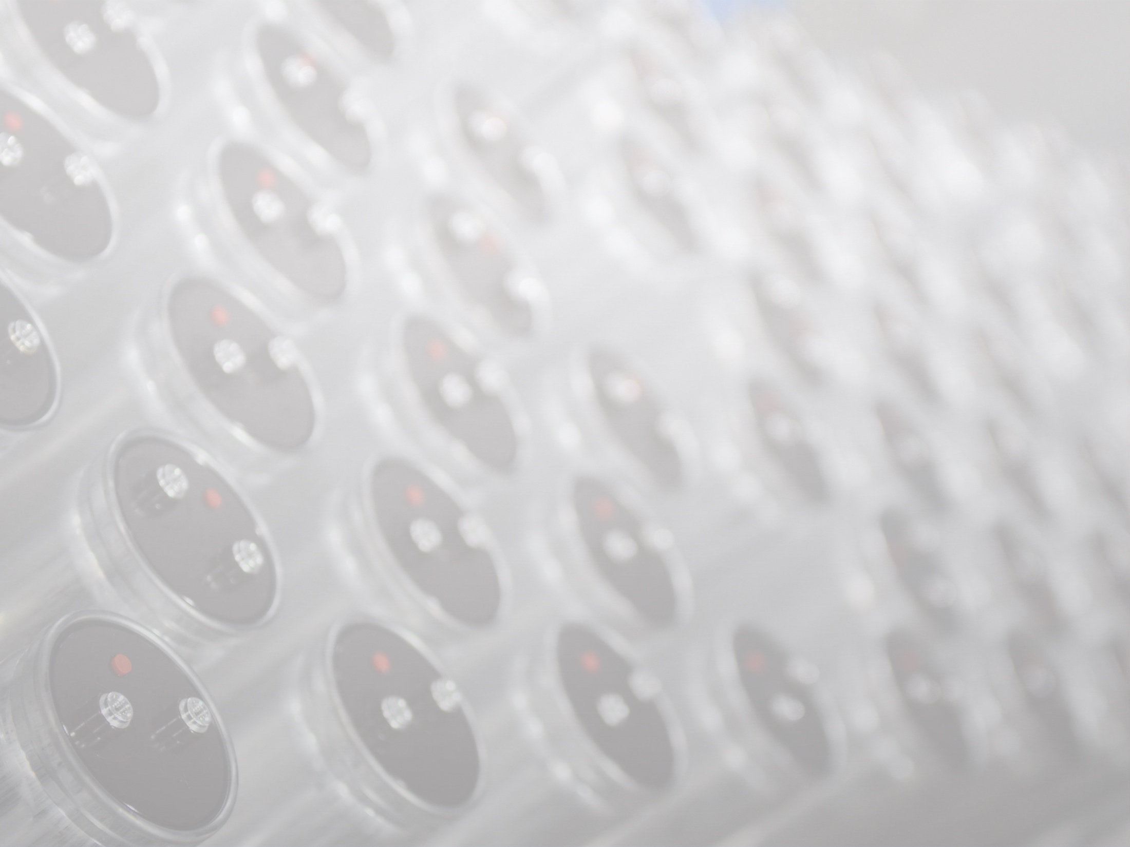


Slide 2
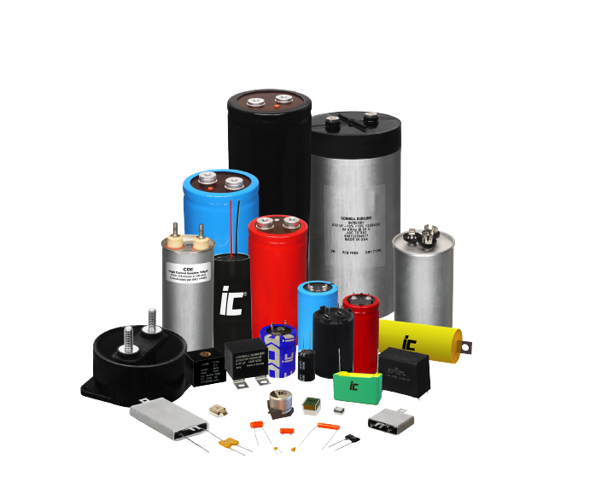
Cornell Dubilier
A privately-held company headquartered in Liberty, SC, Cornell Dubilier Electronics is a technology leader and manufacturer of high quality capacitors used in demanding industrial, medical and military/aerospace applications

Slide 3

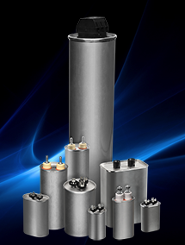
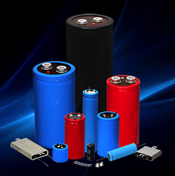
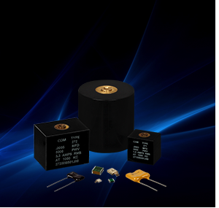
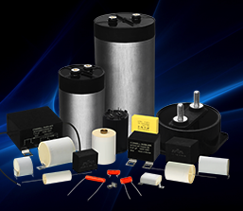
CDE Core Products
AC & DC
Oil-Filled
Aluminum Electrolytic
DC Film
Mica
Screw Terminal
Snap-in
Flatpack
Axial and Radial
SMT
DC Link
Snubber
Axial and Radial
SMT
1Ø and 3Ø Harmonic Filters
Power Conversion
Motor Run
HID Lighting
RF Dipped
RF Clad
SMT
Transmitting

Slide 4
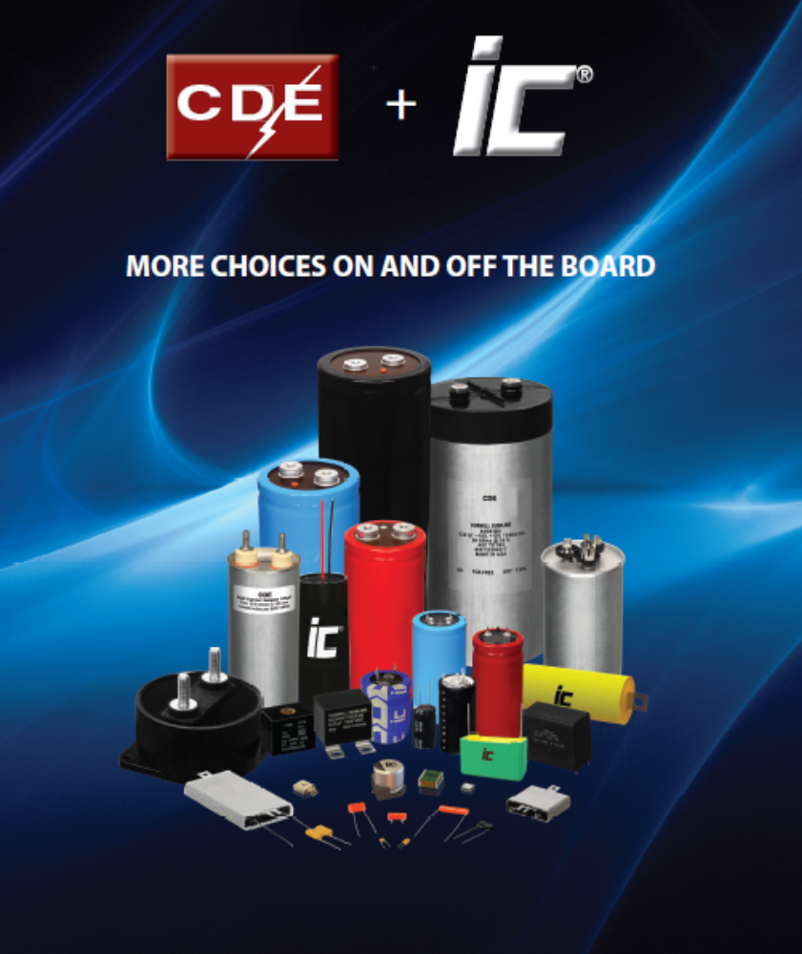
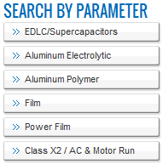
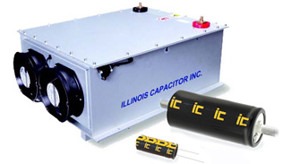
Our Most Recent Acquisition
Illinois Capacitor
Supercap Modules

Slide 5
Markets
1% HVAC
1% Audio
1% HEV
2% Lighting
1% Traction
3% Power Transmission
4% Misc. Industrial
18%
Large UPS Systems
6% Communications
6% Medical Power
15%
Misc. Power Supplies
7% Welding
7% Other
10%
Motors and Motor Drives
7% Renewable Energy
10% Military Aerospace

Slide 6
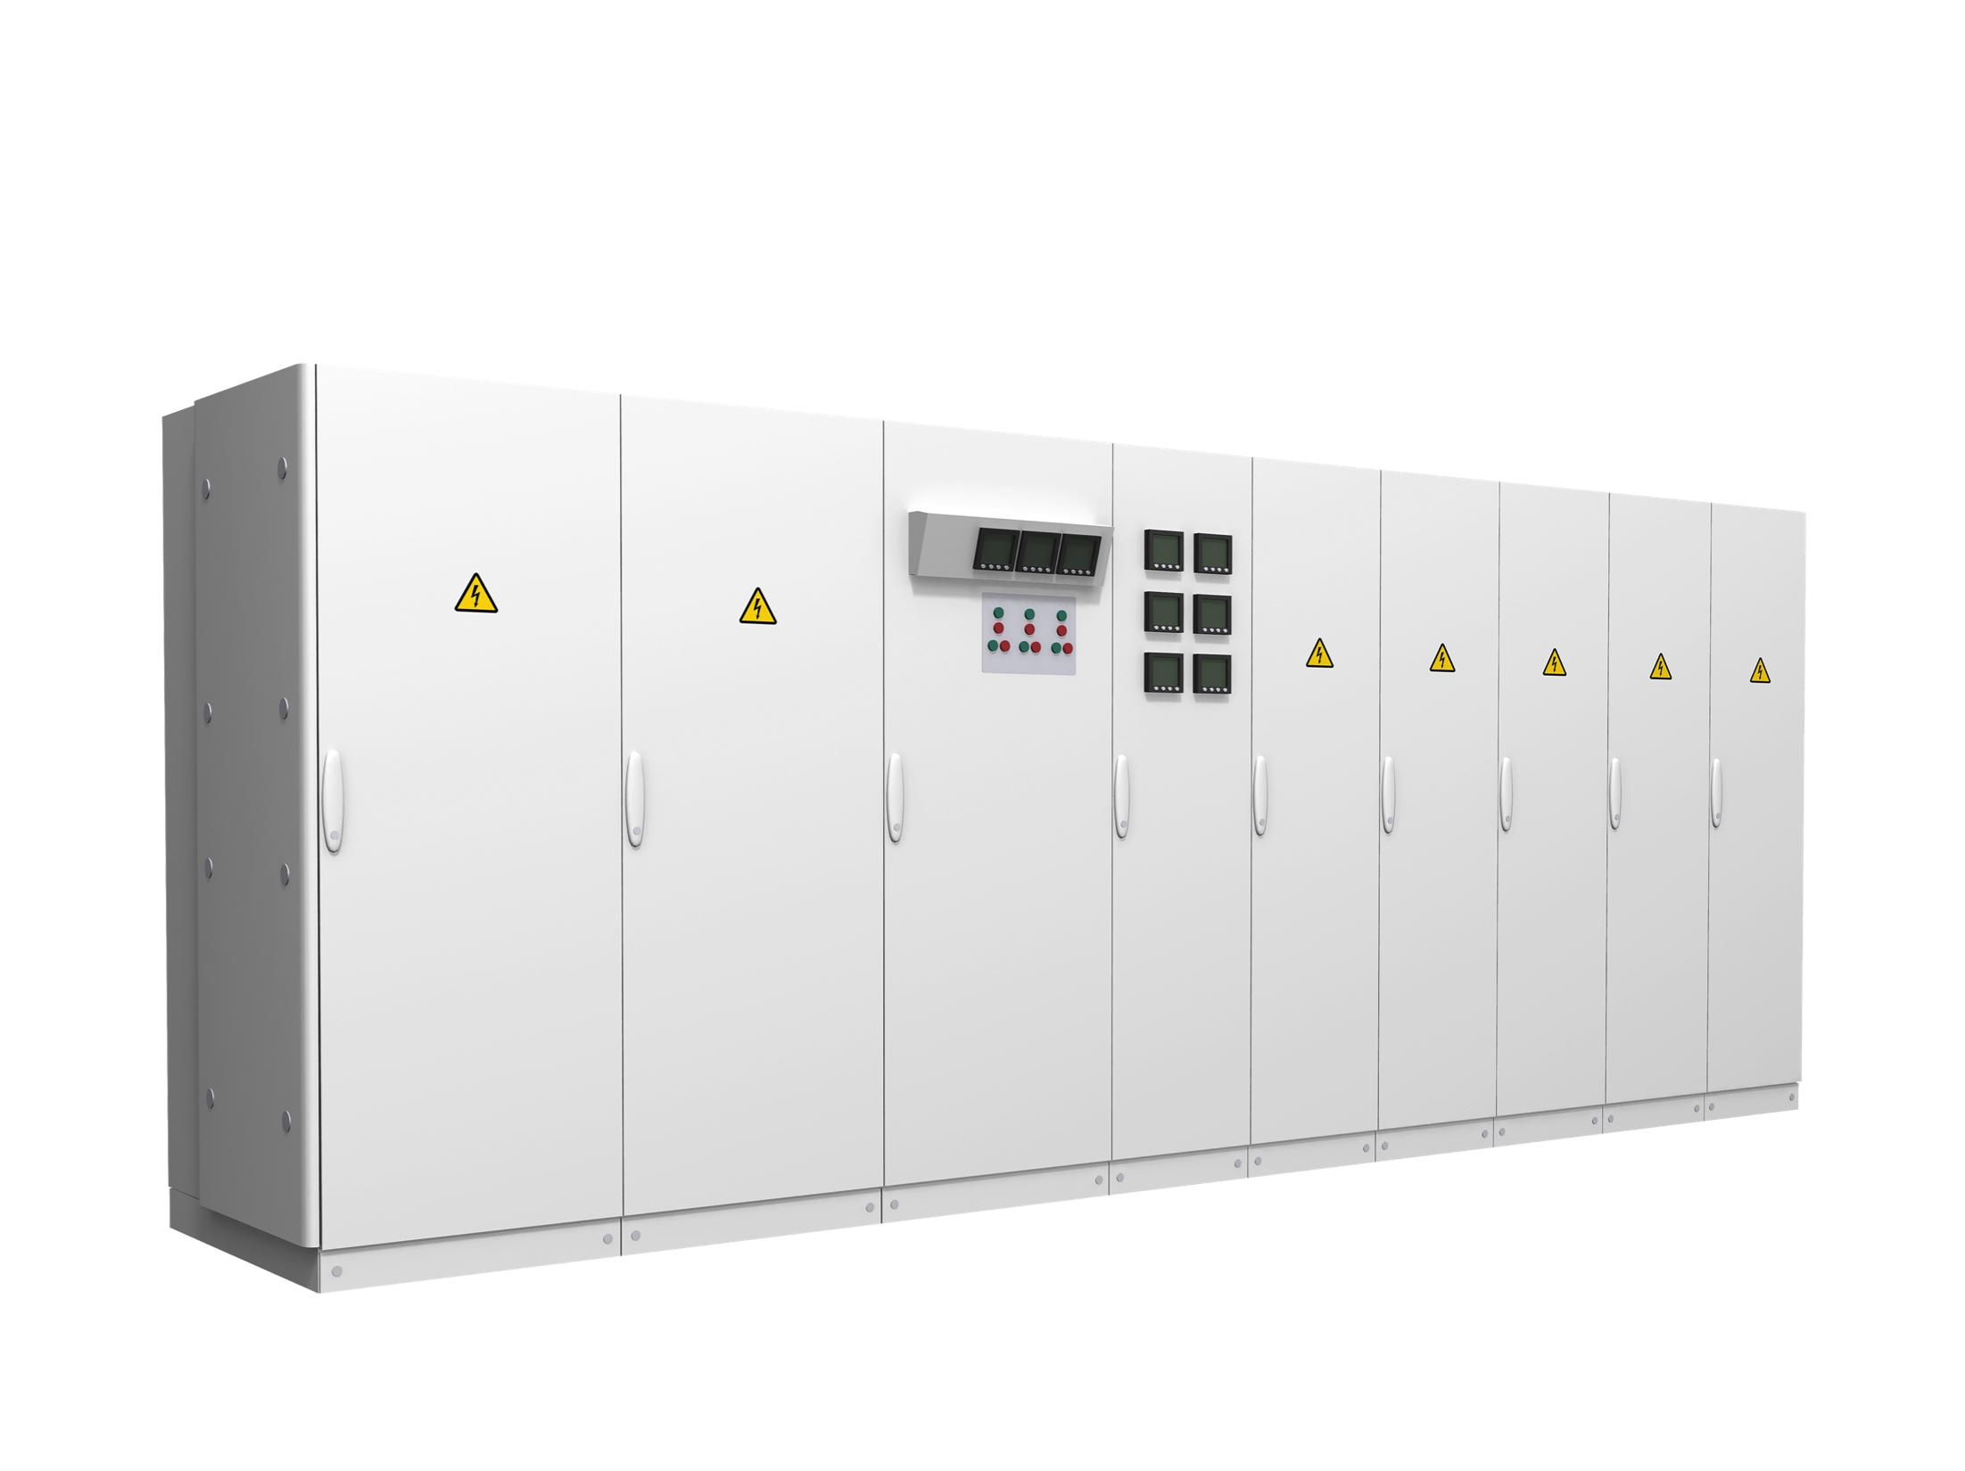
Power Supplies and Backup
Where CDE capacitors are used
UPS
Flywheel Energy Storage
Battery Chargers
Linear Power Supplies
Ferroresonant Power Supplies
Fixed Output and Programmable Power Supplies

Slide 7

Industrial
Where CDE capacitors are used
Welders
Motors and Motor Drives
Motion Control
Elevators
HVAC Systems

Slide 8
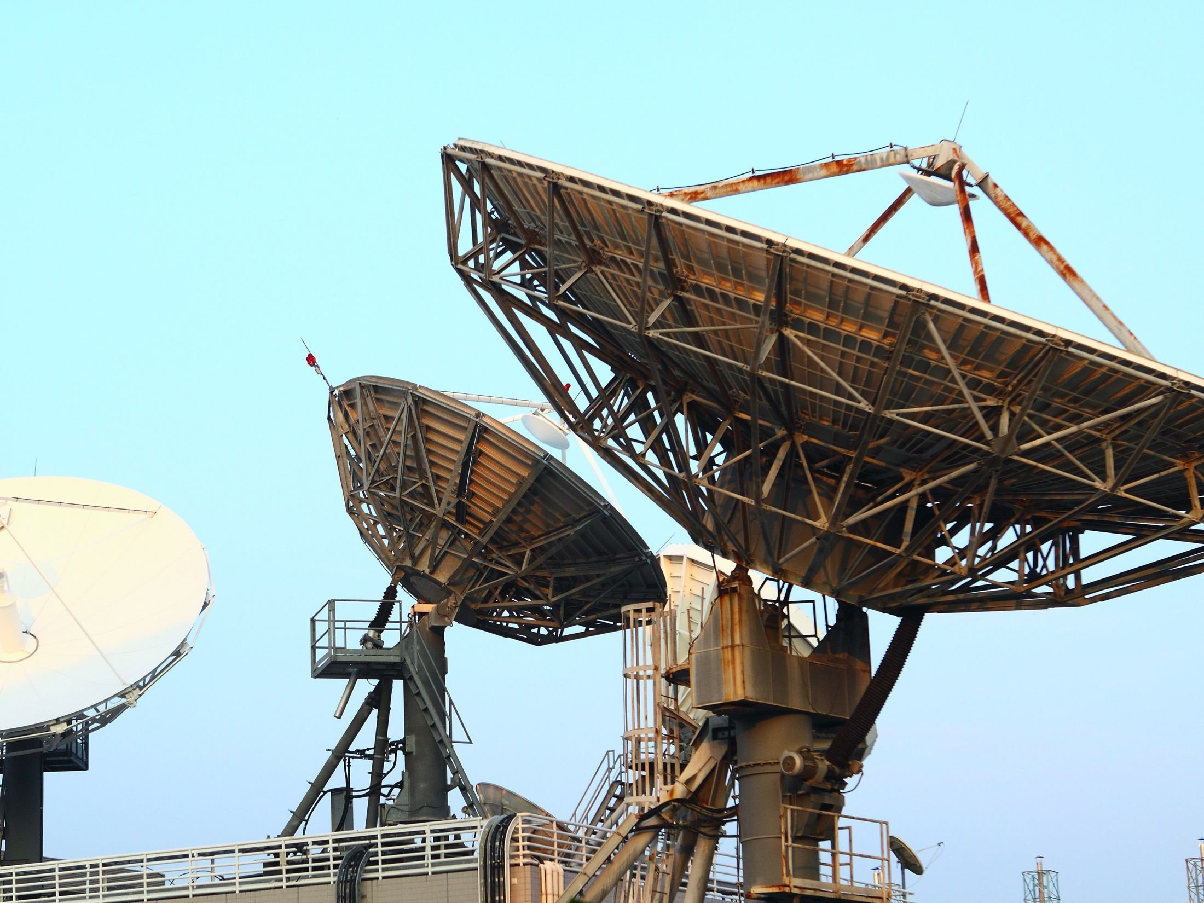
Military and Aerospace
Where CDE capacitors are used
Radar
Commercial and Military Aircraft Power Supplies
Cockpit Communications
Black Box Recorder

Slide 9
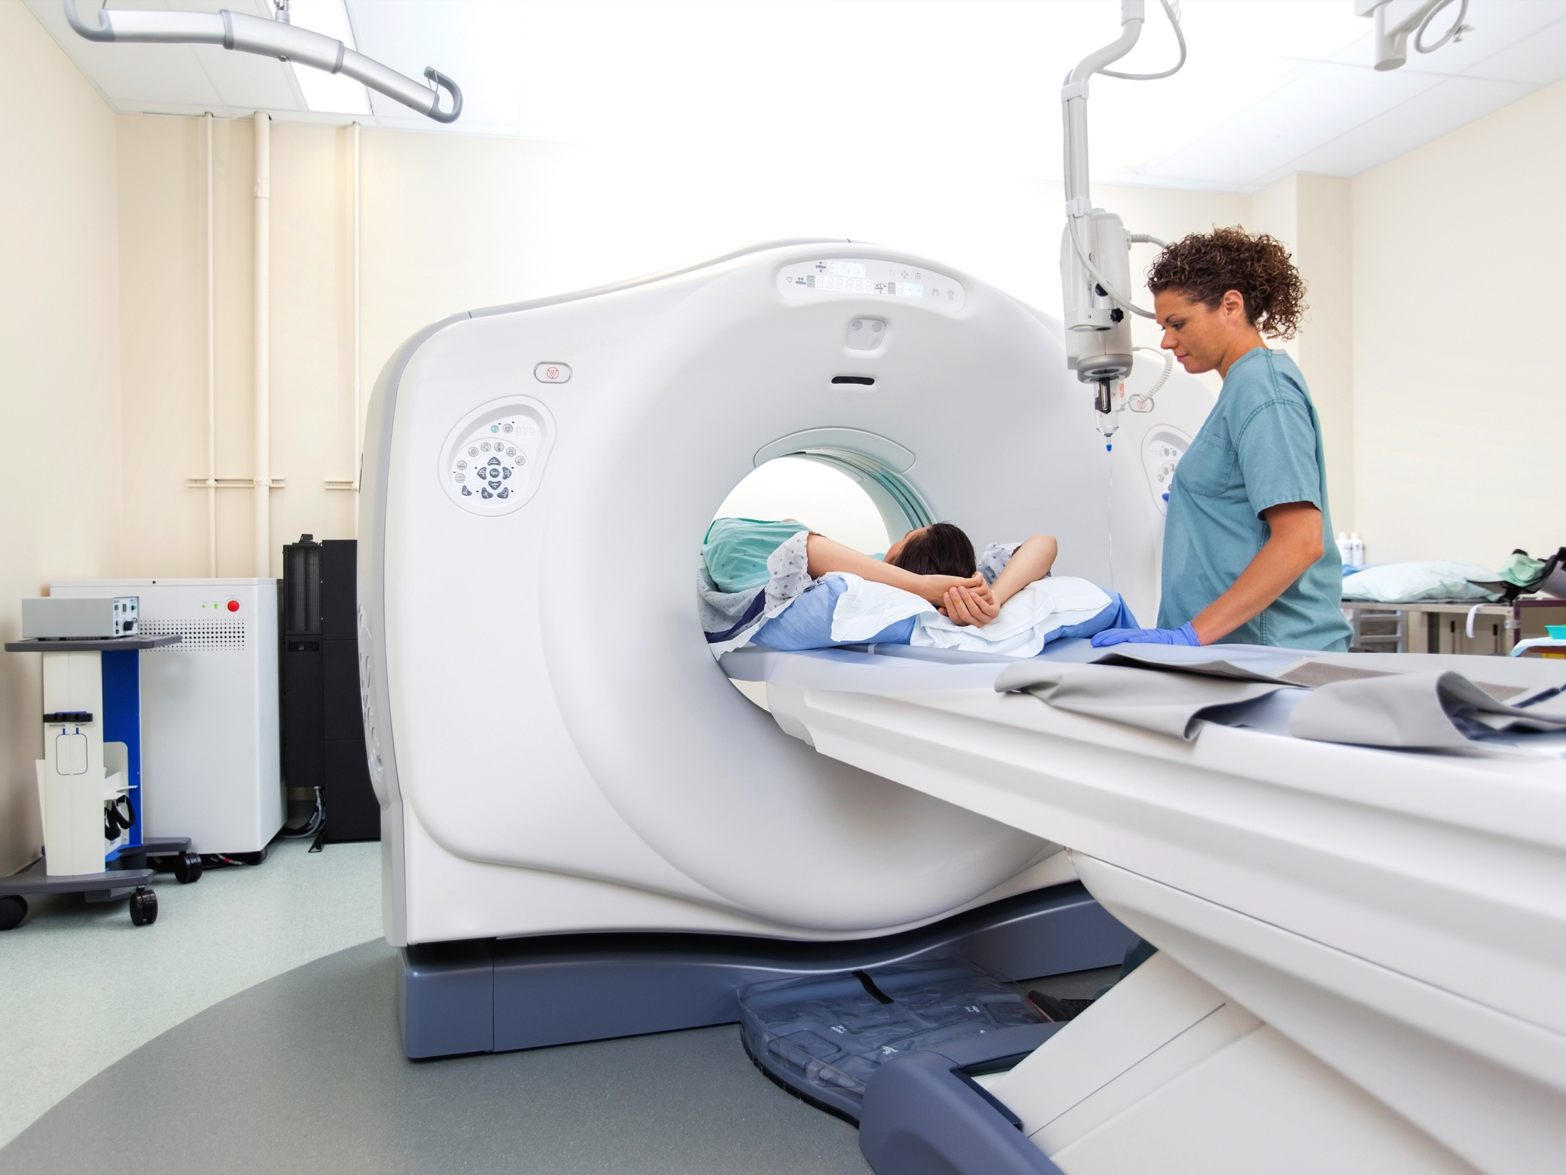
Medical
Where CDE capacitors are used
MRI
X-ray
Lasers
RF Ablation
Oxygen Concentrators

Slide 10

Renewable Energy
Where CDE capacitors are used
Grid Tie and Commercial PV Inverters
Wind Inverter
Fuel Cell Inverter

Slide 11

Lighting
Where CDE capacitors are used
HID Lighting
Professional Photography
Strobe
LED

Slide 12
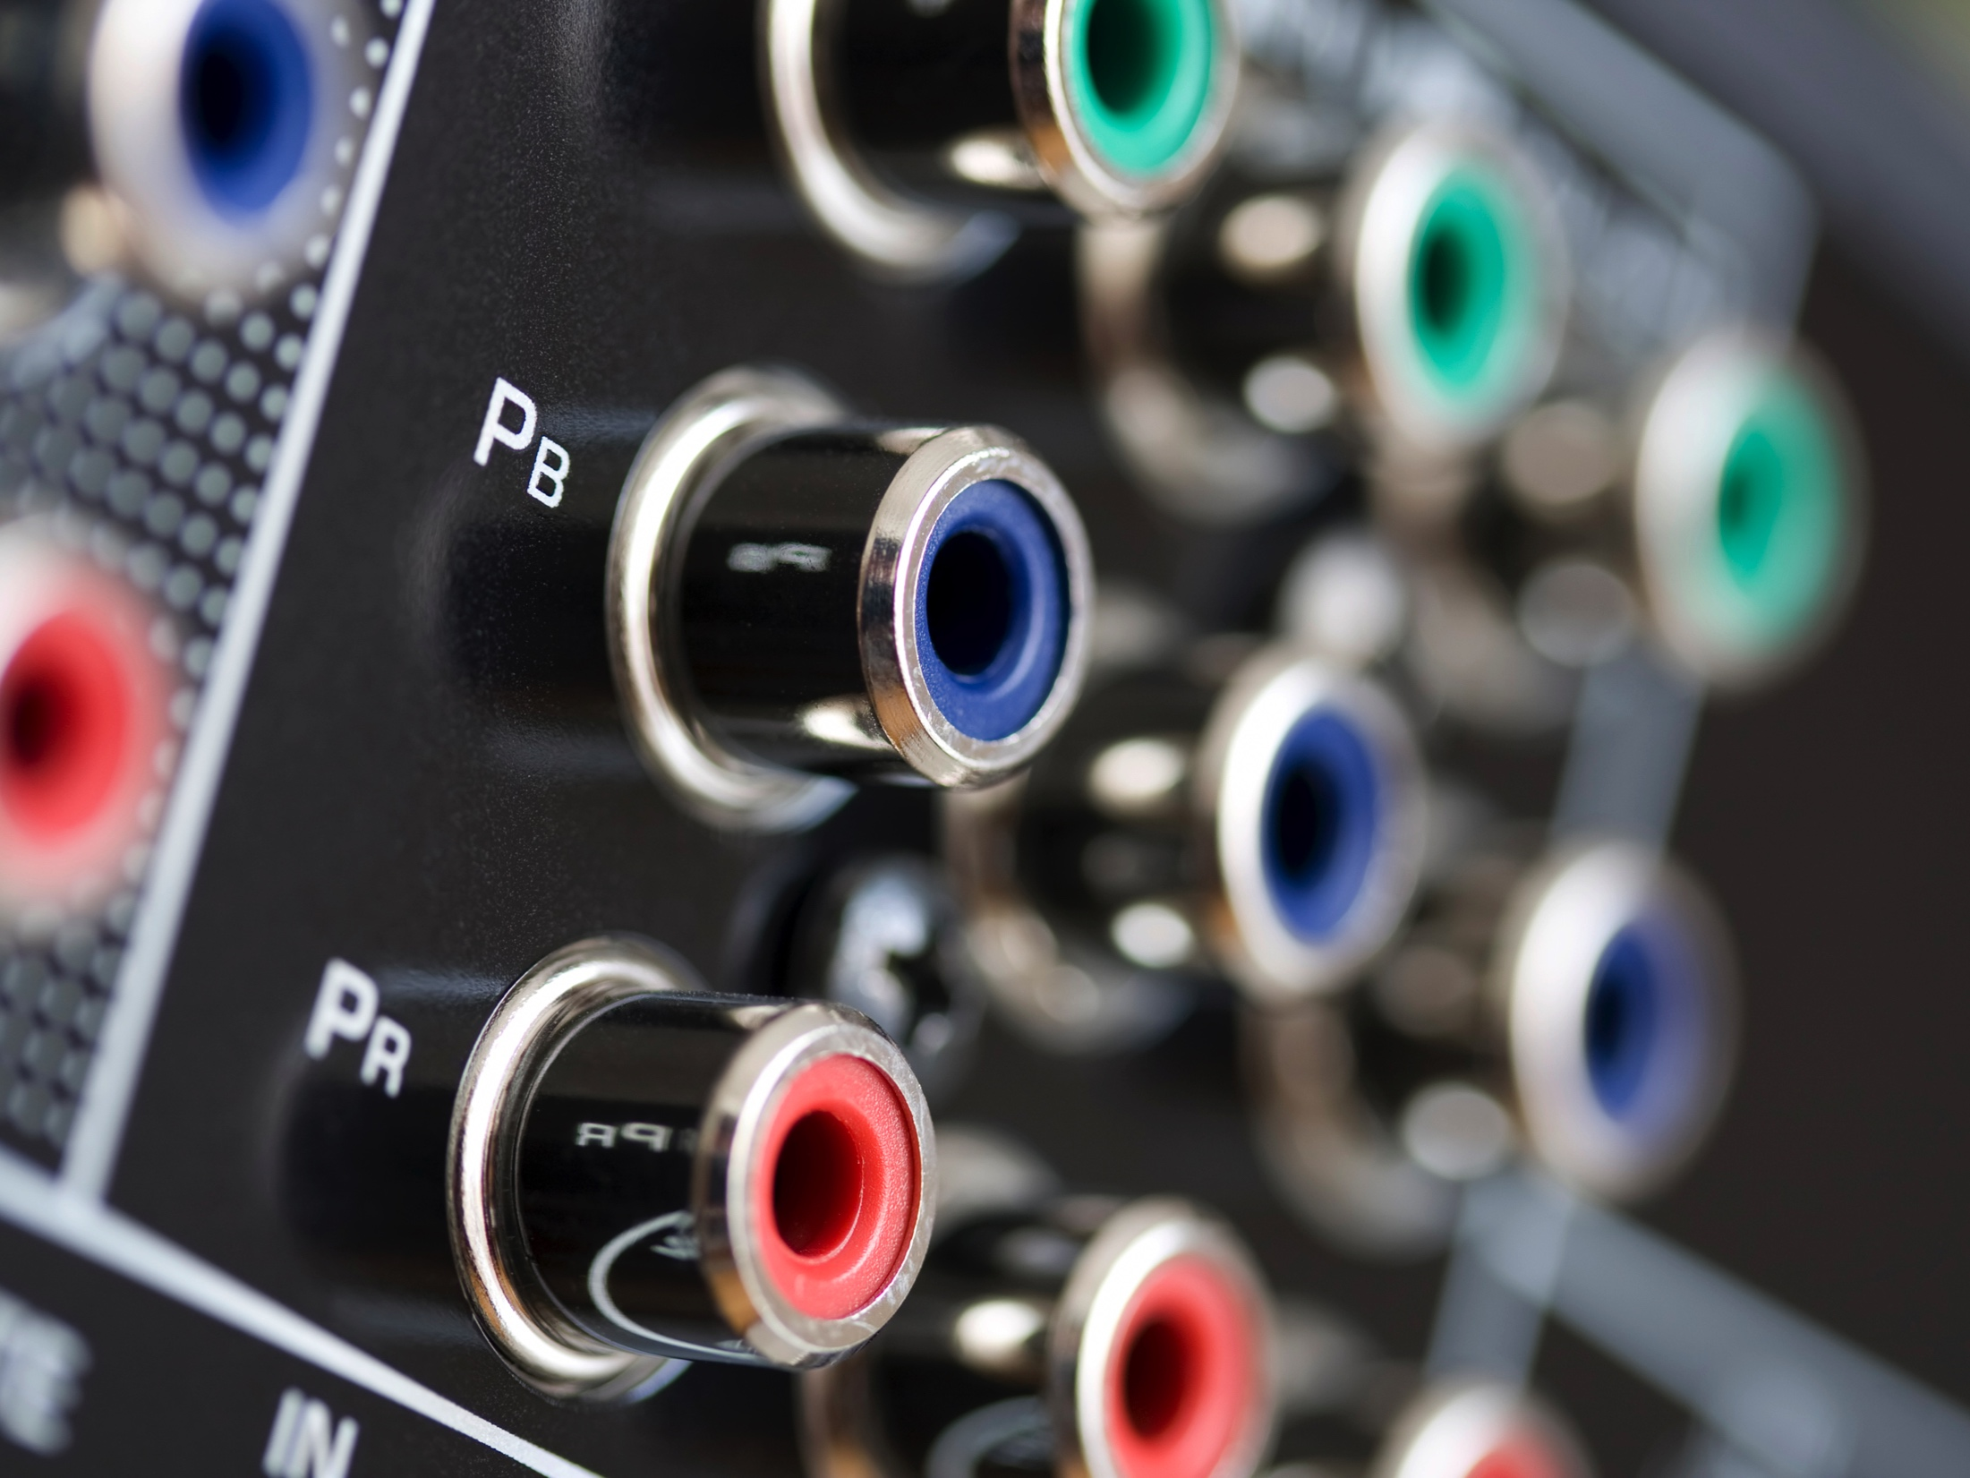
Audio
Where CDE capacitors are used
Audio Amplifiers
Guitar Tone Circuits
Battery Stiffening
RF Tuning Circuits

Slide 13



























Global OEM Partners

Slide 14
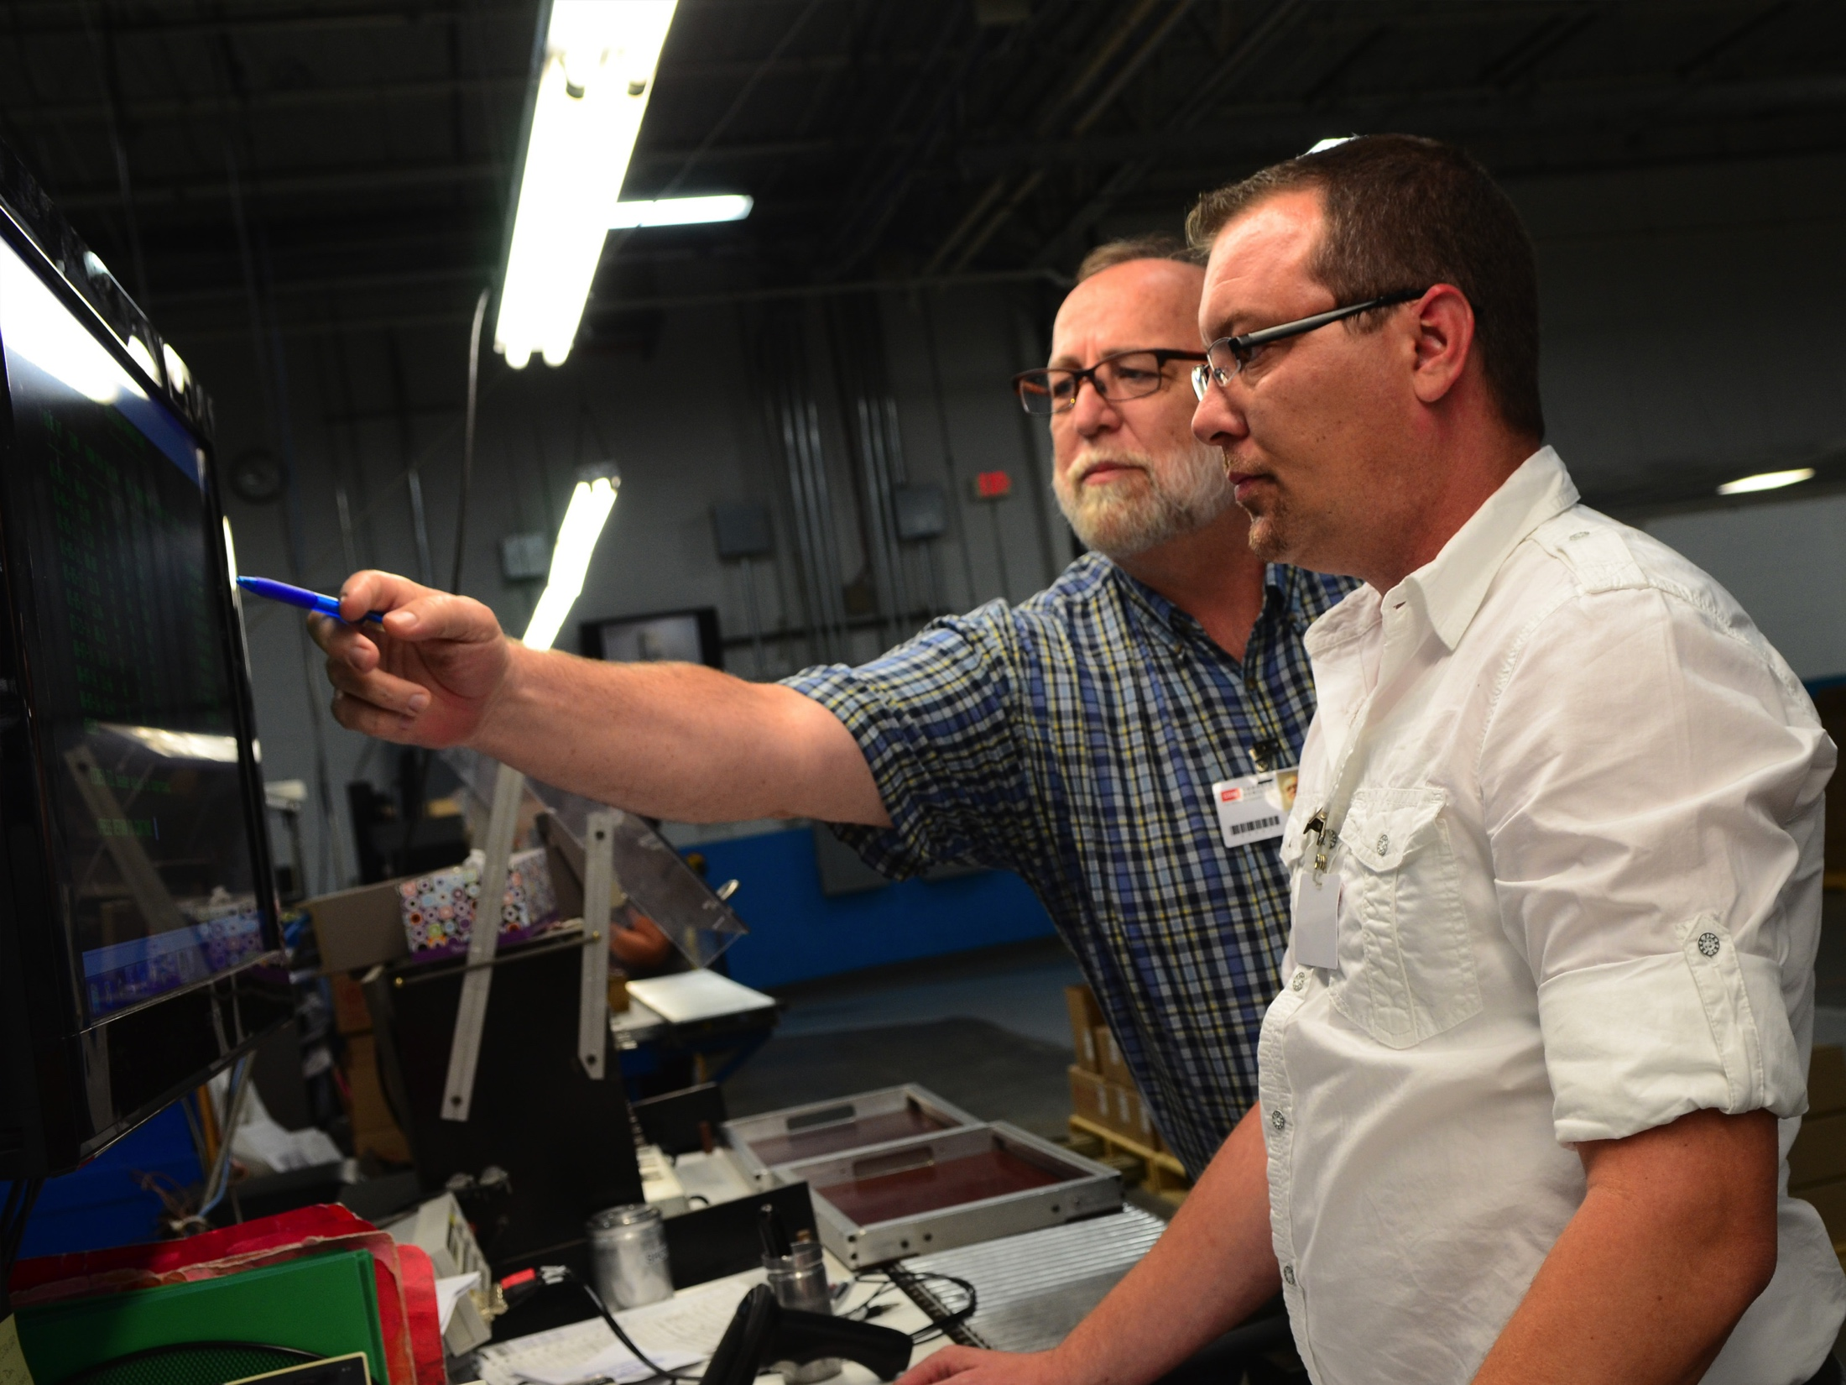
Experts in every industry application

Slide 15
Our engineers are eager to collaborate
Whether your project requires a standard capacitor or a custom solution, our engineers will work with your team to arrive
at the optimal solution

Slide 16

Innovation driven by research

Slide 17
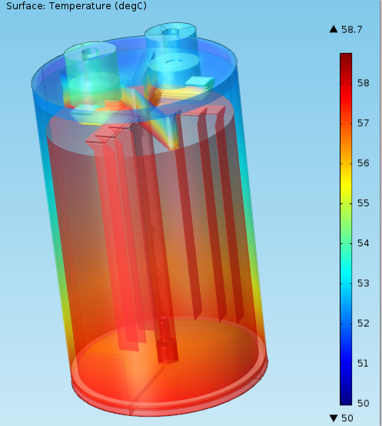
Our Technology
R&D Center located in Liberty, South Carolina
Advancing aluminum electrolytic technology, especially in the area of prismatic form factors
Thermal and physical modeling of capacitors using COMSOL
Advanced electrical and physical testing and analysis techniques.
COMSOL THERMAL MODEL OF SCREW TERMINAL
ELECTROLYTIC

Slide 18
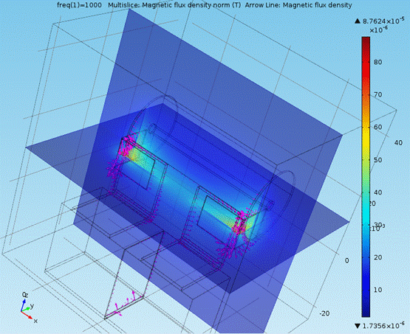
Our Technology
AC and DC Film Capacitor Development Center Located in New Bedford, Massachusetts
Advancing AC and DC film technology to remain at the forefront of capacitor development in this dielectric technology
COMSOL MAGNETIC FLUX DENSITY MODEL OF IGBT SNUBBER

Slide 19
Facilities
  Liberty, SC: Corporate headquarters, Aluminum Electrolytic R&D Center and manufacturing
  New Bedford, MA: Distribution Center and Engineering Development Center for AC and DC Films
  Mexicali, Mexico: Manufacturing
  Chicago, Illinois: Logistics center and Illinois Cap Customer Service Center for OEM Sales
  Kwun Tong, Kowloon, Hong Kong: Asia Sales and logistics center

Slide 20
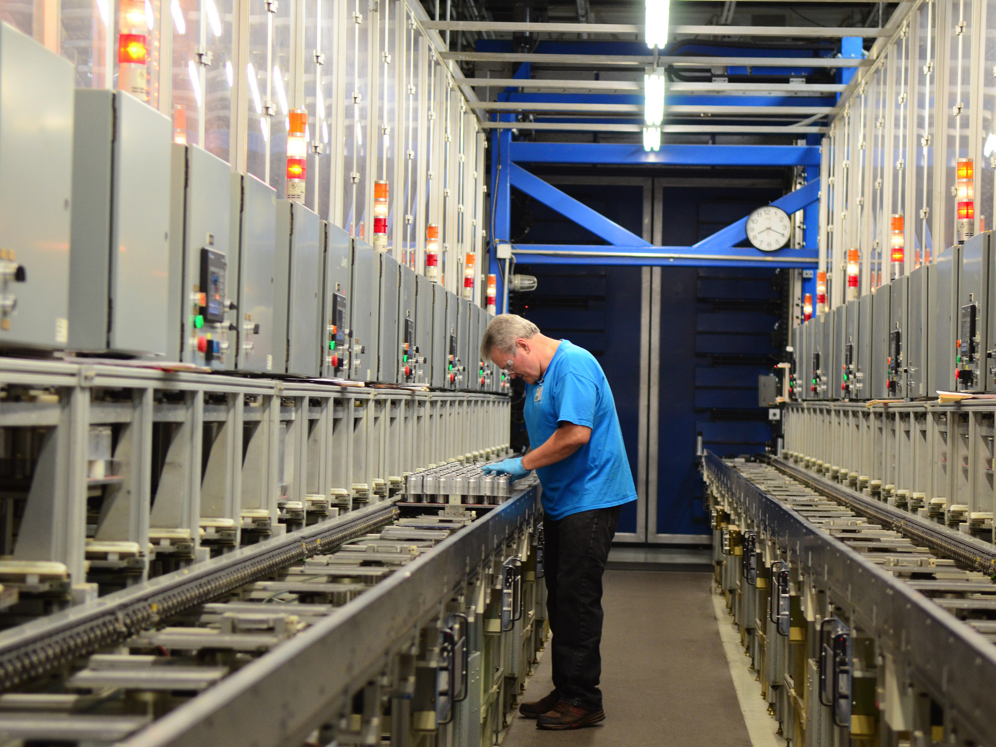
Liberty, South Carolina
Manufacturing Facility: 15,000 M², 205 People, 12 Engineers

Slide 21
Liberty, South Carolina
Home of CDE Headquarters and our principal manufacturing site for Screw Terminal Aluminum Electrolytic and Transmitting Mica
Manufacturing Facility: 15,000 M², 205 People, 12 Engineers

Slide 22
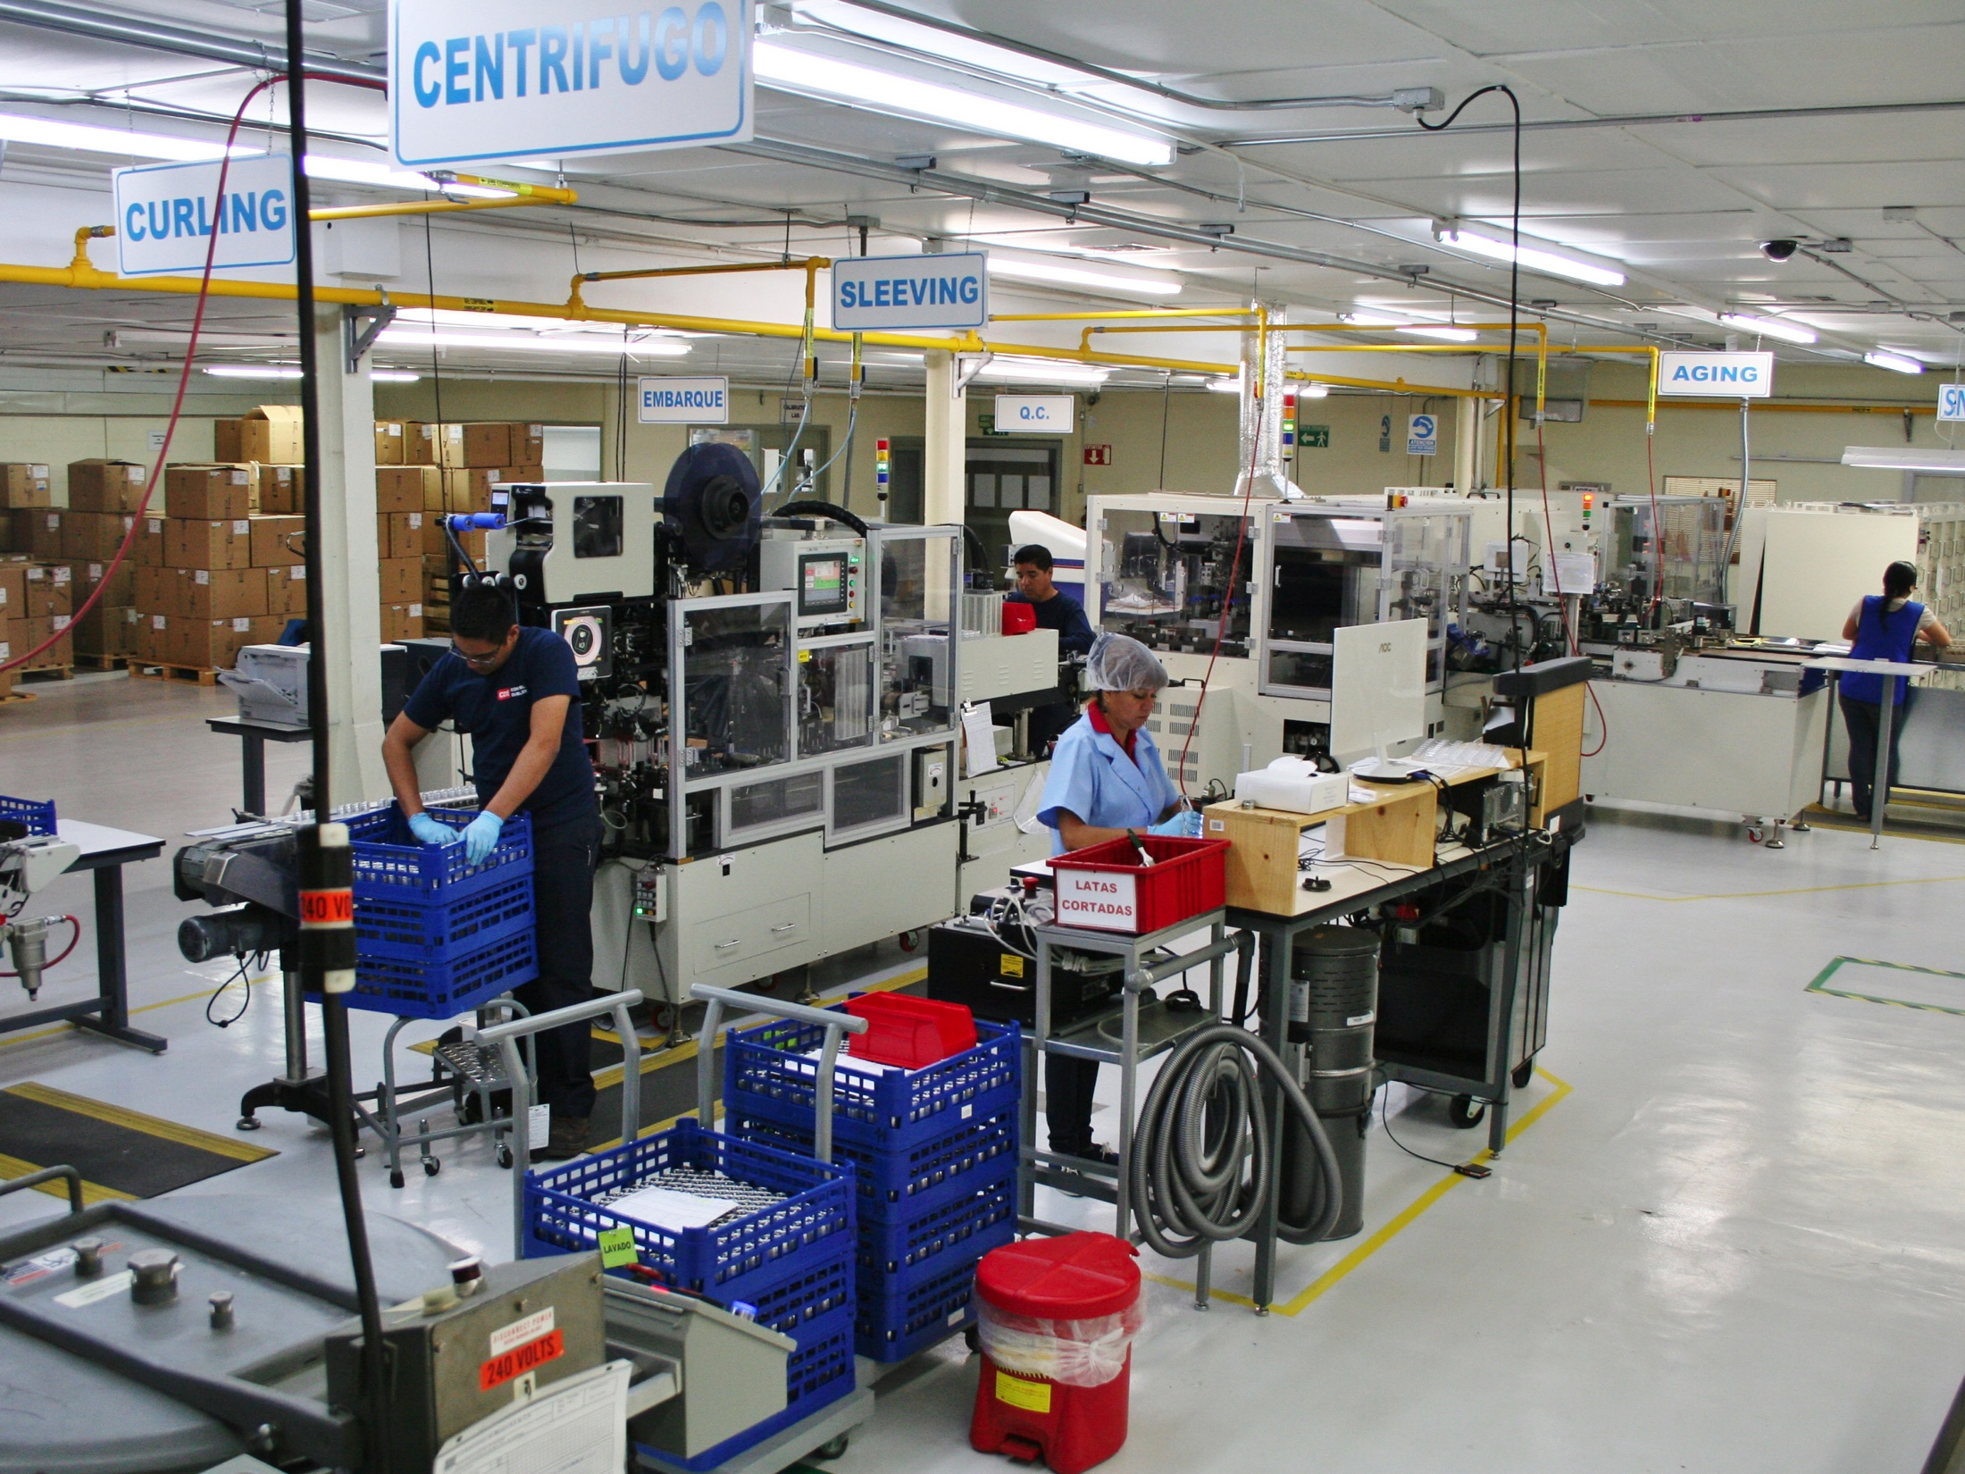
Mexicali, Mexico
CDE Manufacturing Facility: 11,000 M2, 400 Employees, 11 Engineers

Slide 23
Mexicali, Mexico
Located just across the Southern California border, this facility is the largest mica capacitor factory in the world. Capacitors manufactured here include:
Snap-in Aluminum Electrolytic
AC Power Film Capacitors
DC Film Capacitors
IGBT Snubbers
Mica Capacitors
CDE Manufacturing Facility: 11,000 M², 400 Employees, 11 Engineers

Slide 24
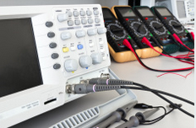
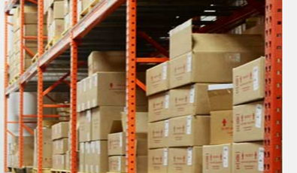
New Bedford, MA
37,000 M², 48 Employees, 8 Engineers
Located 60 miles south of Boston, this facility services all of the company’s distribution business with thousands of stocked SKUs.
It is also our Engineering Center for all Film and Mica Capacitor products

Slide 25
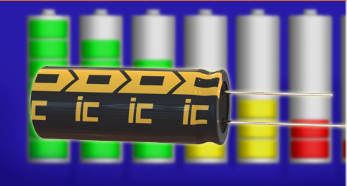
Chicago, Illinois
3,000 M², 19 Employees, 2 Engineers
Located in the Chicago area, this facility houses operations for Illinois Capacitor Customer Service, Engineering, Warehousing and Logistics.

Slide 26
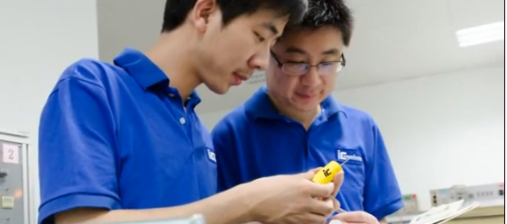
Hong Kong
Asia Sales and Logistics: 1,500 M², 19 Employees, 2 Engineers
Our Asia sales office and logistics center is located in Kwun Tong, Kowloon, Hong Kong. Staffed with 19 people including sales engineers, customer service personnel, application engineers and technicians.

Slide 27
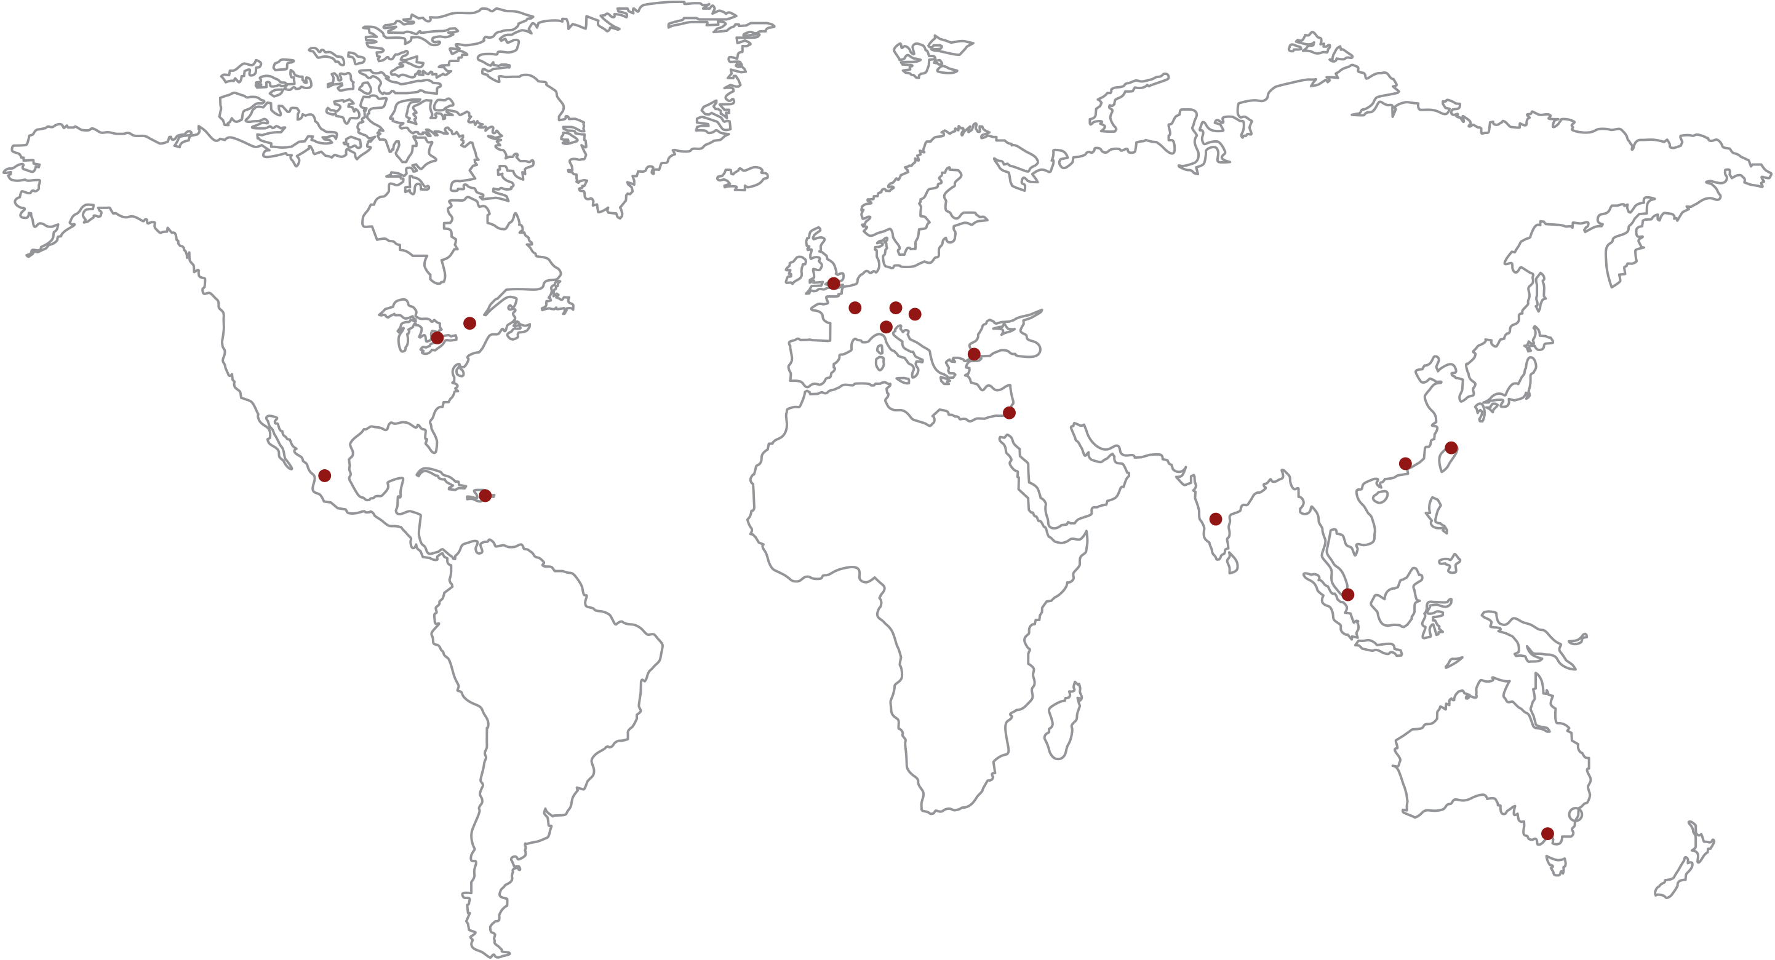
Global Sales Channels
CDE International Sales Offices are conveniently located in North America,
Asia and throughout Europe

Slide 28
Global Sales Channel
Our Distributor Partners reach more than 30,000 customers worldwide
Direct Customers

Slide 29
The CDE Advantage
We have a broad portfolio of standard capacitor products for Power Electronics
We excel with applications and custom capacitor designs for critical applications
Access to CDE engineers
Global logistics, sales and distribution network

