Slide 1

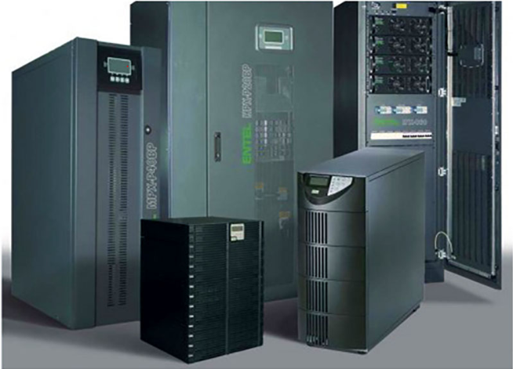

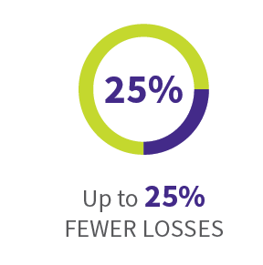
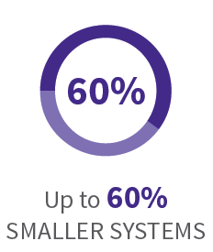
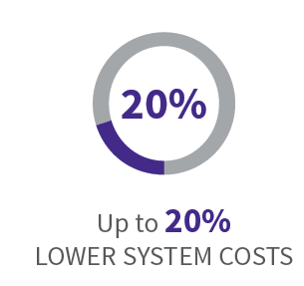

Our Silicon Carbide wide bandgap semiconductors far outperform conventional silicon components and set new standards for efficiency and reliability in applications for aerospace, commercial, industrial, transportation, energy exploration, renewable energy, solar, test and measurement, and more.
Wolfspeed SiC Delivers
*when compared to traditional Si semiconductors
Notes:
These are the high-profile applications (UPS, rail, electric vehicles, solar) driving SiC adoption and Wolfspeed’s investments in expansion…it’s all about efficiency, from SiC itself to the end application.

Slide 2
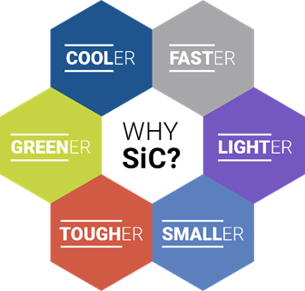

POWERING THE FUTURE
Silicon Carbide (SiC) Power Semiconductors
What is Silicon Carbide?
  Compound semiconductor base material
Types of Wolfspeed SiC Power Products:
  Bare Die Schottky Diodes and MOSFETs
  Discrete Schottky Diodes and MOSFETs
  Power Modules
Silicon Carbide vs. Silicon:
  Higher power conversion capability
  Faster switching speeds
  Improved thermal performance
Notes:
Primary message/value proposition is captured in the graphic. Customers choose SiC when they need their power design to enable one or more of those six attributes AT THE SYSTEM LEVEL. Keep bringing the message back to those, especially the intuitive ones: Cooler, Faster, Lighter, Smaller. Greener refers to less wasted power due to SiC increasing the system’s efficiency. Tougher refers to SiC improving power system reliability, as the SiC devices themselves are rugged (withstanding high voltage and high temperatures) and can reduce total component count in a design.
What is SiC?
Compound semiconductor Base material for our power products, enabling operation at high voltages or high junction temperatures, or both depending on the application.
SiC vs Si:
SiC can handle higher voltages and more amps than Si across temperature, and the on-state resistance Rds(on) is relatively constant over temperature (Si Rds(on) increases as temperature increases).
SiC can switch much faster with lower switching losses than Si.
SiC conducts heat better than Si, and can run hotter without sacrificing reliability.

Slide 3
THE WOLFSPEED ADVANTAGE
Wolfspeed Is the World Leader in SiC Products
Why SiC?
Why Wolfspeed SiC?
Moving from Si to SiC offers:
  Higher efficiency
  Faster switching
  Improved thermal performance
  Higher reliability
Any power supply design from 600V and up has the potential to benefit from switching to SiC
Wolfspeed invented the SiC MOSFET in 2011
30+ years of SiC power with 6+ trillion installed field hours
Wolfspeed is Investing for the Future
#1 market share in SiC technology, doubling capacity by 2021
17+ Years of Diode and MOSFET Production Thousands of customers with millions of MOSFETs and diodes
Focused Development and Customer Support
ALL resources dedicated to developing SiC capacity, devices, packages, and to providing superior applications support
Notes:
Any power supply has the POTENTIAL to benefit from SiC, but where we really add value is in the high voltage (>600V), high power (anything in the kW) arena.
Emphasize that making Silicon Carbide products is all we do, 24/7/365…SiC truly is the best technology that can meet the power efficiency needs of the future.

Slide 4

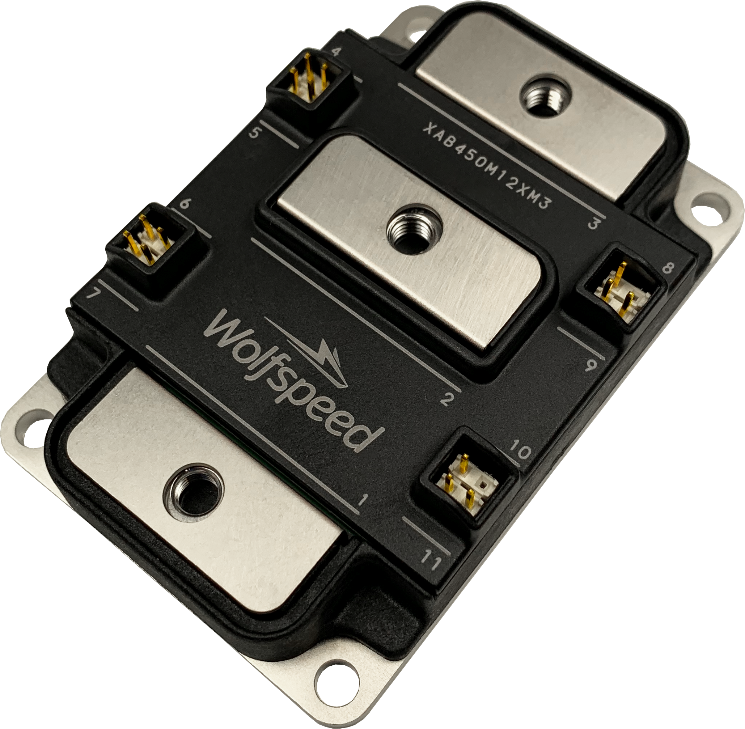
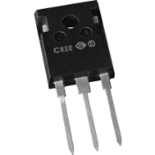
THE WOLFSPEED ADVANTAGE
The Only Vertically-Integrated SiC Manufacturer
Grow Silicon Carbide Boules
Slice & Polish Wafers
Grow Epi & Fabricate Devices
Package Die
Notes:
Same story as LED…just different packages.

Slide 5

THE WOLFSPEED ADVANTAGE
Global Manufacturing and Support
HQ in Research Triangle Park, NC with approximately 1500 employees across 11 locations on 3 continents
2 SiC Fabs in RTP & Durham, NC
Multiple silicon carbide Growth Facilities
Multiple packaging facilities in USA, Malaysia, and China
Headquarters:
RTP, NC, USA
Manufacturing
Sales Office
Application Centers

Slide 6
POWERING THE FUTURE
Automotive SiC Adoption Accelerates Growth
Auto makers are investing $300B in the electrification
of vehicles
  SiC is their material of choice, will drive SiC economies of scale
  Auto industry has the highest performance, quality and supply requirements
  Wolfspeed has AEC-Q101 qualified parts
Significant system cost savings*
  Battery costs reduced by up to $320 to $640 per car
  Space costs reduced by up to $600 per car
  Cooling costs reduced by up to $500 to $1000 per car
Driving range increases 20%
  Reduced battery weight
  Smaller components throughout the system
  Reduced heat from inverter
EV Applications
  Powertrain Inverter
  On-board Charger
  Charging Station
* Source: Goldman Sachs 2018 Report on Silicon Carbide
Notes:
Why talk about cars to a non-automotive audience? EV volume drives manufacturing economies of scale, making the cost of silicon carbide-based power solutions attractive to the broader market.
CRITICAL detail: When talking about system/BOM cost savings (just like LED!) be sure to say that while using SiC in the powertrain and on-board charger adds $300 of incremental cost to the system, look at what that $300 buys for the auto makers at the system level. Reduction in battery cost alone more than covers the cost of SiC.
Other details:
- Auto makers are investing heavily in electric vehicles, and they need SiC power solutions because we enable ALL of the attributes in the graphic more effectively than any other technology.
SiC manufacturing capacity must grow rapidly to support ever-growing numbers of electric vehicles. As manufacturing scales up, costs go down…just look at the flat panel TV market.
Automotive quality requirements enable high reliability for all markets.

Slide 7
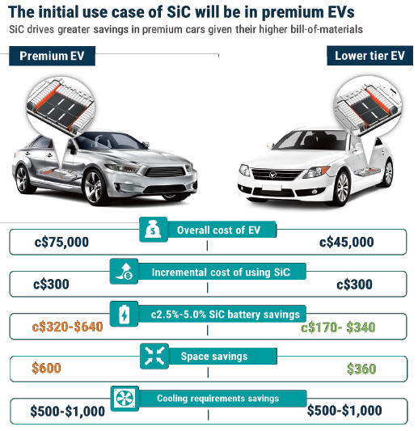
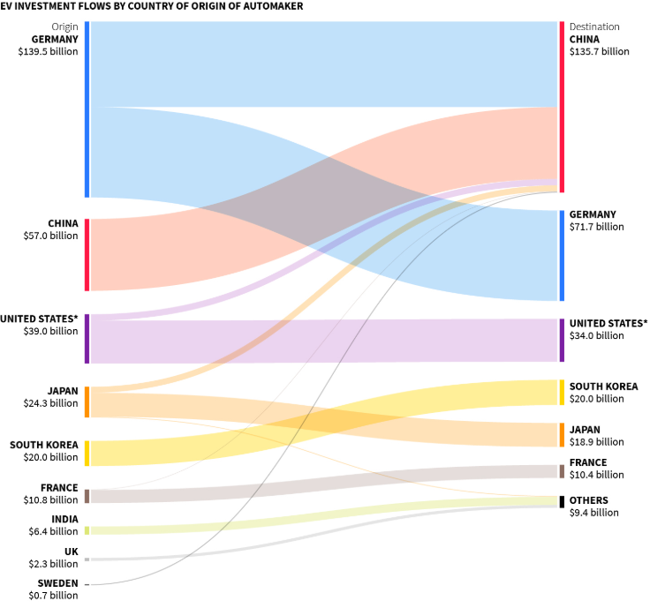
POWERING THE FUTURE
Automotive SiC Adoption Accelerates Growth
$300Bn EV Investments
System
Savings/Car
$1,530
$1,065
Sources: The next leg of growth in power semiconductors Goldman Sachs, November 2018 Reuters: VW, China Spearhead 300 Billion Global Drive to Electrify Cars, January 2019
Notes:
Why talk about cars to a non-automotive audience? EV volume drives manufacturing economies of scale, making the cost of silicon carbide-based power solutions attractive to the broader market.
CRITICAL detail: When talking about system/BOM cost savings be sure to say that while using SiC in the powertrain and on-board charger adds $300 of incremental cost to the system, look at what that $300 buys for the auto makers at the system level. Reduction in battery cost alone more than covers the cost of SiC.
Other details:
- Auto makers are investing heavily in electric vehicles, and they need SiC power solutions because we enable ALL of the attributes in the graphic more effectively than any other technology.
SiC manufacturing capacity must grow rapidly to support ever-growing numbers of electric vehicles. As manufacturing scales up, costs go down…just look at the flat panel TV market.
Automotive quality requirements enable high reliability for all markets.

Slide 8

THE WOLFSPEED ADVANTAGE
Ready for the Future
4X
3X
2X
1X
Initial Capacity Expansion
2019 Capacity Expansion
2021+ 8X Capacity Investment
Wolfspeed is #1 is SiC market share, and is investing heavily for the future
Notes:
Wolfspeed is investing not only in capacity expansion, but also R&D in process technology, chip design, packaging for both discrete devices and modules, etc. to continue advancing SiC capabilities.
We’re also hiring the absolute best product marketing people. Especially the new power guy. He ROCKS.

Slide 9
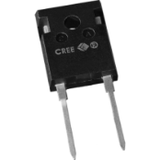
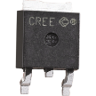
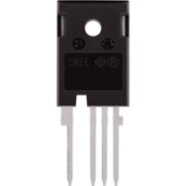

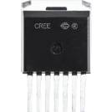
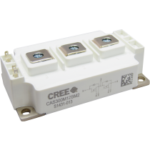
POWERING THE FUTURE
Power Product Portfolio at a Glance
SiC Schottky Diodes and MOSFETS
Up to 1700V rating
  Diodes: 600V to 1700V
  MOSFETs: 900V to 1700V (650V coming Q4 19)
Up to 100A current rating (package limited)
SiC Power Modules
Up to 1700V rating
Up to 450A current rating
Half-bridge and three-phase configurations
SiC Bare Die Schottky Diodes and MOSFETs
Up to 1700V rating
Up to 196A current rating
Example Package Options

Slide 10
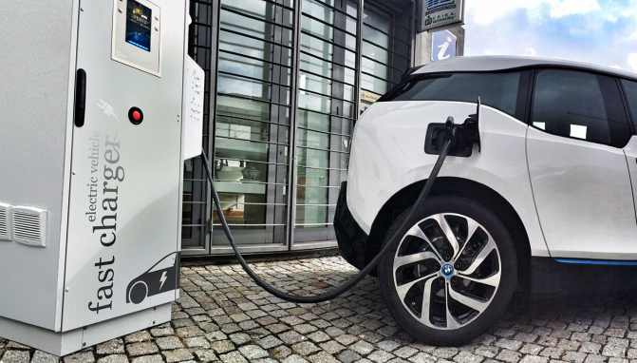






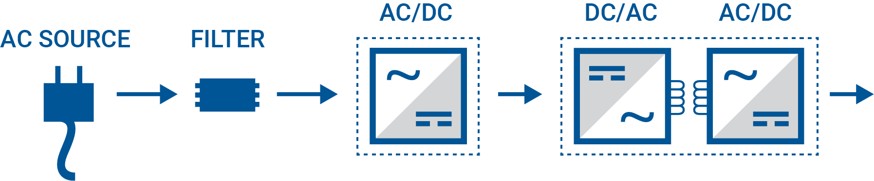
INDUSTRIAL APPLICATION
Fast Charger for Electric Vehicles
What: Silicon Carbide Power Modules or MOSFETs and Diodes
Where: Electric vehicle battery
off-board charging 80kW – 150kW.
DC charge from station to car, or any other type of electric vehicle. Typically constructed from multiple 15kW-20kW blocks.
Why: Minimize the size and weight of the charging station while maintaining
a 30-minute-or-less charge time.
Wolfspeed SiC Advantage: Up to 30% lower losses and 2x-3x faster switching speed. Deliver 65% increase in power density, 30% fewer components.
Notes:
Choose any/or all Apps based upon customer relevance: 2-pager reference design is available on Cree Connect
Smaller. Lighter. Faster..back to the core value proposition.

Slide 11






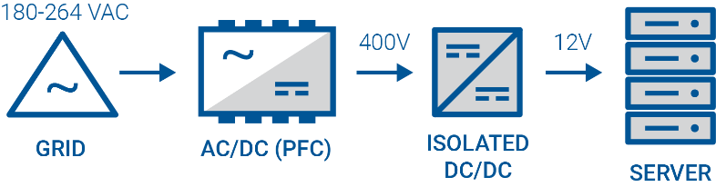
INDUSTRIAL APPLICATION
High Efficiency Power
for Data Centers
What: Silicon Carbide MOSFETs and Diodes
Where: Data centers for cloud computing
Why: Maximize computing capability while minimizing electricity consumption —
cooling system can be up to 40%
of the electricity cost
Wolfspeed SiC Advantage:
Achieves 80+ Titanium standards
Lower total bill of materials cost
Contributes to 620 billion kWh in
energy savings from 2010 to 2020
Notes:
Choose any/or all Apps based upon customer relevance 2-pager reference design is available on Cree Connect
Cooler. Smaller. Greener...back to the core value proposition.

Slide 12


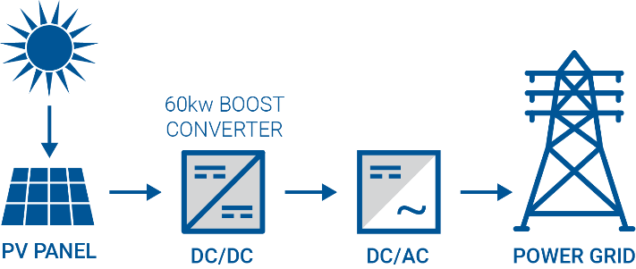
SiC
Si
ENERGY / INDUSTRIAL APPLICATION
VS
Inverters for Solar Power and Energy Storage
What: Silicon Carbide MOSFETs
and Diodes
Where: Solar panel array boost converter to provide input voltage
for battery charger and/or power
grid inverter
Why: Minimize size and weight while increasing ruggedness for lower installation and maintenance costs
Wolfspeed SiC Advantage: 99.5% efficiency enables over 60% smaller size and 10x lighter weight
Notes:
Choose any/or all Apps based upon customer relevance. 2-pager reference design is available on Cree Connect
Smaller. Lighter. Tougher...back to the core value proposition.

Slide 13
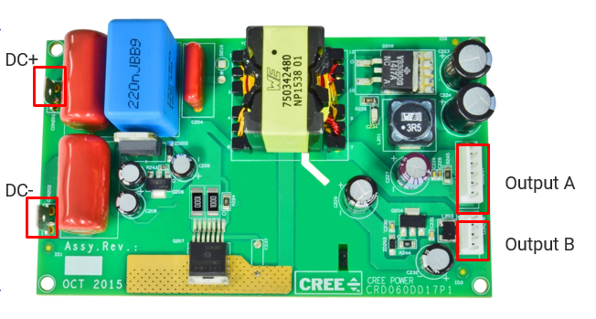


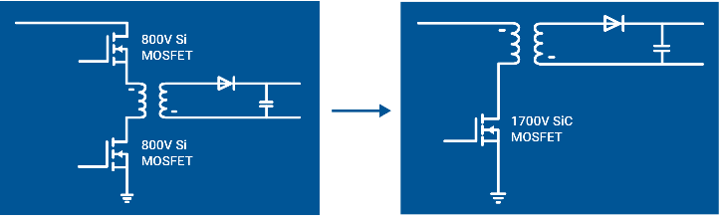
INDUSTRIAL APPLICATION
Low Power Auxiliary SMPS
What: Silicon Carbide MOSFETs and Diodes
Where: High-voltage systems that require low-voltage auxiliary power supplies for controllers, displays, fans, etc.
Why: Maximize efficiency while reducing footprint, component count, and cost
Wolfspeed SiC Advantage:
Simplifies design by eliminating one MOSFET
Fast switching frequency reduces size
of components
Eliminates heatsink, lowering total
BOM cost
Notes:
This application illustrates that even a relatively-simple power supply can benefit from switching from Si to SiC.
Cooler. Smaller. Faster...back to the core value proposition.
Choose any/or all Apps based upon customer relevance. 2-pager reference design is available on Cree Connect

Slide 14
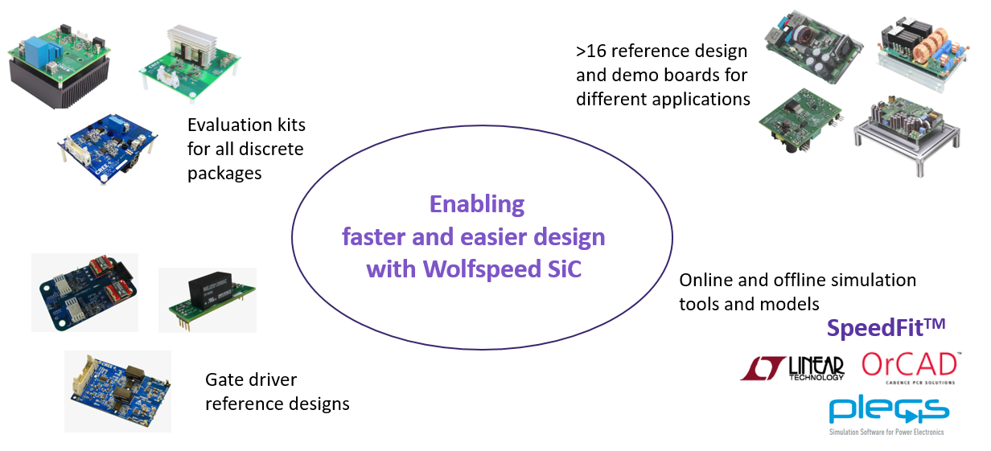
THE WOLFSPEED ADVANTAGE
Design Support Tools

Slide 15


