Slide 1
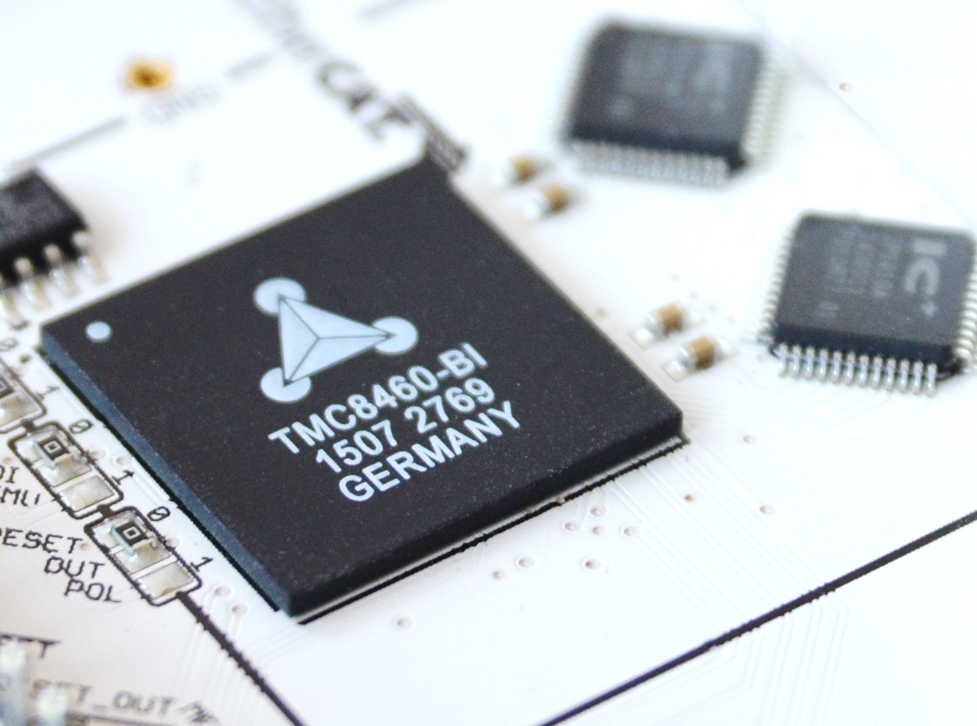

TMC846x-BI
TRINAMIC extends Portfolio with EtherCAT Slave Controller ICs
General Introduction

Slide 2
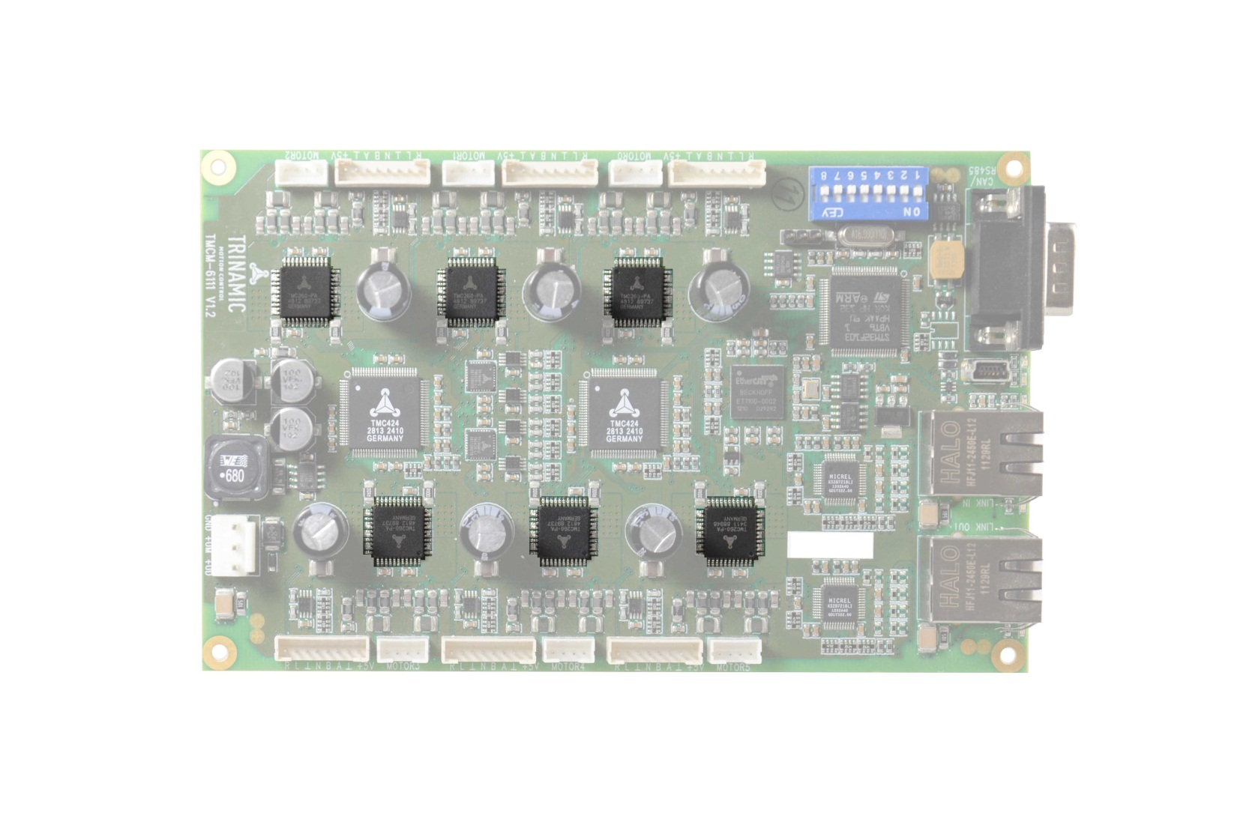
Our „ECOSYSTEM“
Motor Driver and Gate Driver

Slide 3
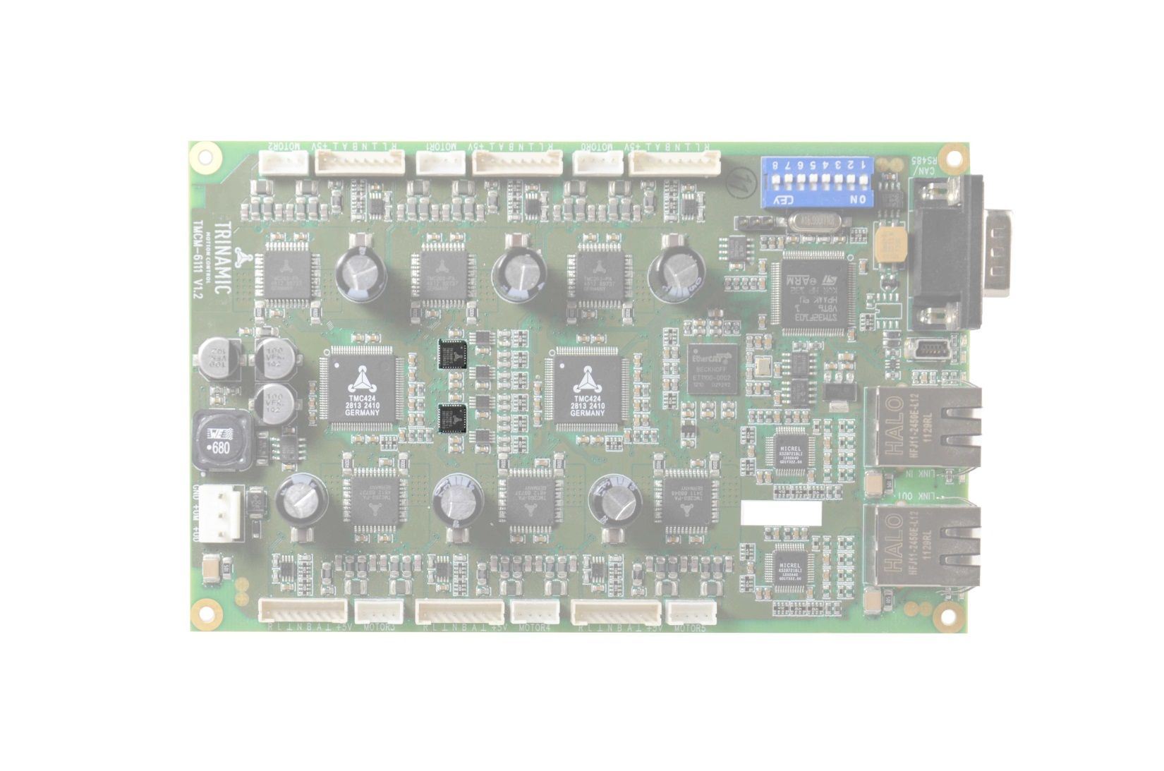
Our „ECOSYSTEM“
Dedicated Motion-Controller IC

Slide 4
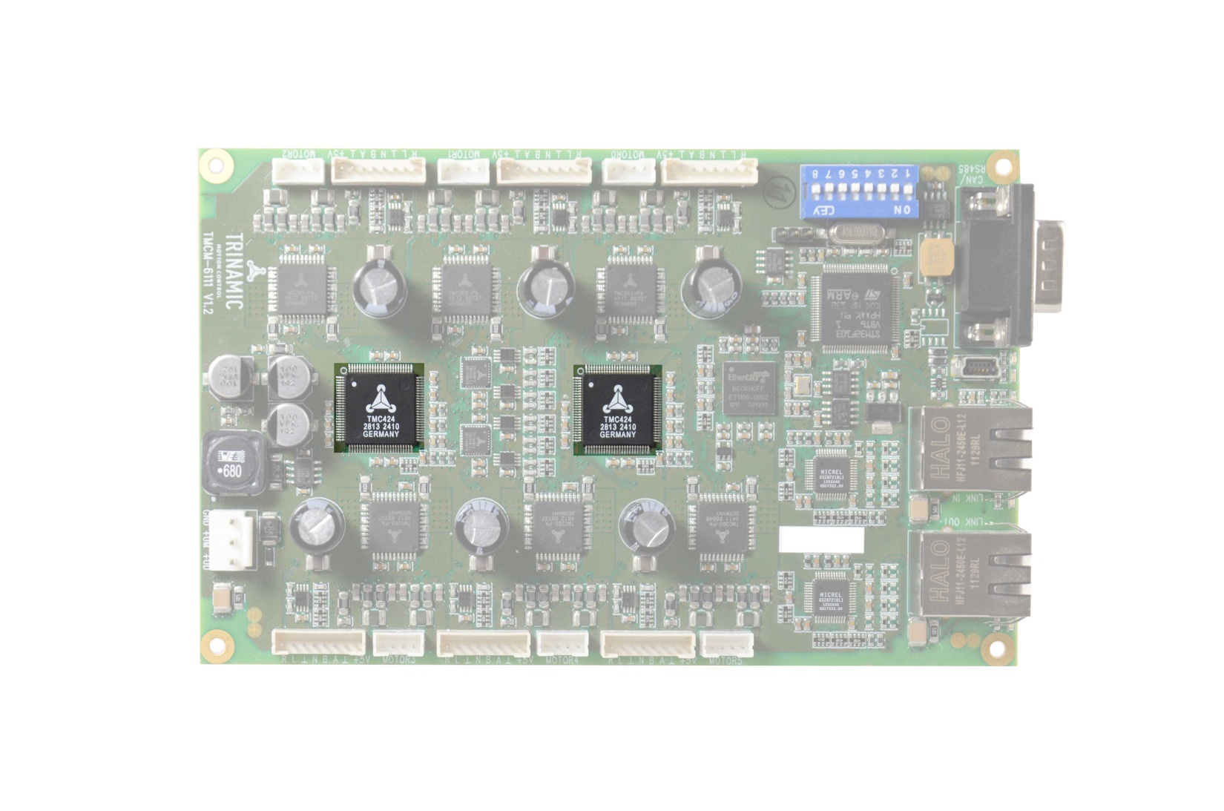
Our „ECOSYSTEM“
Encoder Interfaces

Slide 5
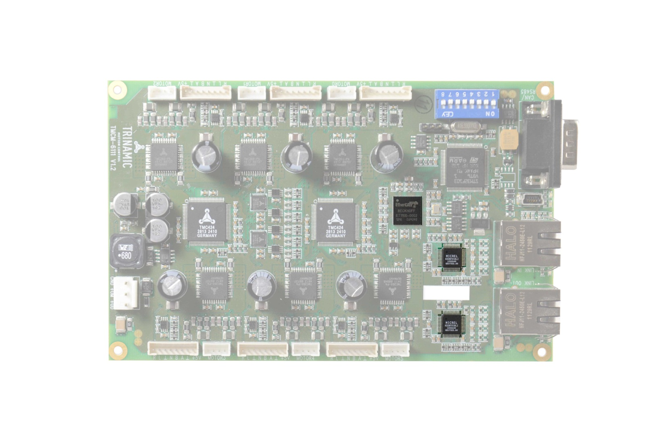
Where do we want to go to?
→ Expand ECO system with new interface solutions
Interfaces: EtherCAT and other

Slide 6
TMC846x-BI
TRINAMIC Family of EtherCAT Slave Controllers

Slide 7
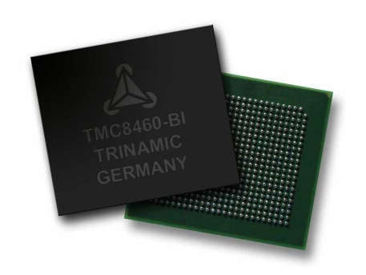

TMC846x-BI Family
3 devices:
TMC8460-BI
  Special Multi Function Block
  Industrial temperature rating
TMC8461-BI
  In addition:
  High Voltage I/Os and Supply (36V)
  Small Package, 10x10mm
  Supply for external logic and peripherals
TMC8462-BI
  In addition:
  2 integrated PHYs
  Small Package, 9x9mm
  For BOM reduction and smallest Footprint
Proven standard compliant EtherCAT engine
Complex real-time IO:
Multi Function and Control IO block (MFC IO) focusing motion & motor control including encoder interface
Extended high voltage and analog capabilities
Integrated 100 Mbit Ethernet PHYs
Robust process / industrial & automotive temperature range

Slide 8
Ethercat slave controller block
Standard compliant ESC engine and register set
2 MII ports to external PHYs, 6 or 8 FMMUs, 6 or 8 SyncManagers, 16K PDRAM, 64bit DC, SPI PDI, PDI/ECAT Reset
Configurable EEPROM size, link polarity, PDI emulation, reset out polarity
Main functions
  ESC configuration, EEPROM interface and status functions
  On-the-fly EtherCAT frame processing and PHY interfacing
  Memory management and data consistency with FMMUs and SyncManagers
  Distributed Clocks engine for real-time control
  Application level interfacing
MII
Main Ethercat Data Path
With Proven ESC Engine
I2C
PDI

Slide 9
MFC IO Block
Complex real-time IO functions
Various function blocks
  ABN, SPI, S/D, PWM, I2C, DAC, GPIO, emergency switch, IRQ, Watchdog
Configurable
  IO crossbar switch
  Selectable register update triggers
  Process data ram mapping
  Various maskable IRQ sources
MII
MFC IO Block
Main Ethercat Data Path
With Proven ESC Engine
I2C
MFC CTRL
PDI

Slide 10
Analog & HV block
8 x High Voltage IO with 3V3 to 24V
1 x switching regulator for int./ext. logic supply (3V3 / 500mA)
1 x configurable switching regulator for ext. components (3V3…24V / 500mA)
1x integrated 3.3V to 1.8V linear regulator for digital core supply
Separate over-temperature shutdowns for switching regulators and HV outputs
Analog & HV
(TMC8461 & TMC8462 only)
MII
MFC IO Block
Main Ethercat Data Path
With Proven ESC Engine
I2C
MFC CTRL
PDI

Slide 11
Integrated PHY block
2x internal 100MBit PHYs to reduce board space and BOM
PHY clock provided internally
PHY supply provided internally
Analog & HV
(TMC8461 & TMC8462 only)
Integrated PHYs
(TMC8462 only)
MII
MFC IO Block
Main Ethercat Data Path
With Proven ESC Engine
I2C
MFC CTRL
PDI

Slide 12
TMC846x-BI Architecture
Supply
Bus Interface
TMC846X
Analog & HV
(TMC8461 & TMC8462)
Integrated PHYs
(TMC8462)
25MHz CLK source
Motor Controller/Driver, Peripherals, IOs
MII
MFC IO Block
ESC /
Main Data Path
I2C
EEPROM
MFC CTRL
PDI
MCU

Slide 13
TMC846x-BI = SBC
TMC846x-BI is not just another EtherCAT Slave Controller.
TMC846x-BI is a System-Basis-Chip (SBC)
SBC
Digital & analog Supply
Complex
real-time IO functionality
High voltage inputs and outputs
EtherCAT Slave Controller / MAC layer
Integrated bus interface (PHYs)
Perfect Software and Tool Support

Slide 14
TMC846x-BI
How do we differentiate?

Slide 15
What is the difference?
 | Challenge | Solution
Real time | Latencies and Jitter by routing Process data through Software Stack | Sophisticated realtime I/O block in hardware, data from PDO may be mapped directly to I/O block, MCU cares for protocol
Temp. Rating | Product to be used in industrial environments | TMC8460: -40…100°C (Industrial) TMC8461/2: -40…125°C (Automotive)
Board Space / BOM | Limited board space | Optimized pinouts TMC8461: small package, SBC functionality integrates switching regulators, 8 high voltage I/O save external circuitry TMC8462:Integrated PHYs

Slide 16
What is the difference?
 | Challenge | Solution
Ecosystem | Short design cycles | Reference designs available Reference firmware stack available Application sample code available
Commercial | Cost | TMC8461: competitive pricing, SBC functions saves external circuitry TMC8462: Integrated PHYs reduce BOM, save external circuitry
Competition | Beckhoff counts quantities – License agreement necessary (applies to Beckhoff components only) | All TMC parts may be ordered and evaluated without license agreement Components may be ordered via standard distribution channels No customer reporting to Beckhoff

Slide 17
What is the difference?
EASE OF USE
ROBUSTNESS
AVAILABILITY
LONGEVITY
MINIATURISATION
INDUSTRIAL
TRUE REAL TIME
MEDICAL
MADE IN GERMANY
„Manufactured in robust high voltage technology…the only one!... “
„Worldwide availability on the market, without any license aggreement. Can simply be ordered at Digi-Key etc. …the only one…“
„Device with long-term availability, ideal for industrial area…only device with longevity guaranty…“
„Smallest device with this feature set and with integrated PHYs“
„Industrial temperature range and more:
-40..+125 → BEST IN CLASS“
„Only Device with optimized architecture for complex real-time I/O“

Slide 18
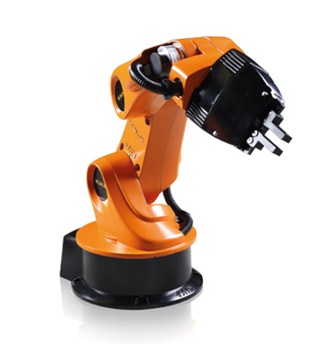
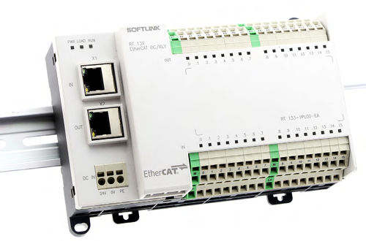
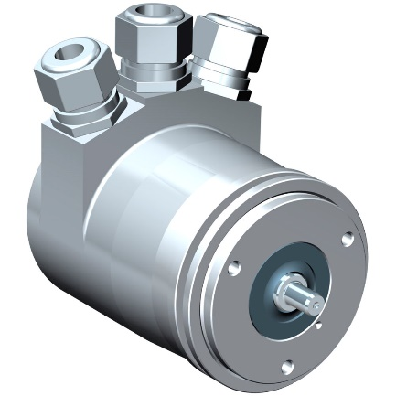
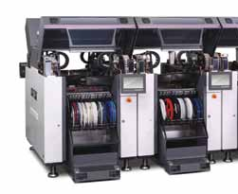
Who are the target Customers?
Whoever
Has hard realtime requirements
Needs reference designs and software
Has limited board space
needs a rugged solutien
and longevity
Bus based
I/O units
Bus based
Encoders
Industrial
Automation
Pick and Place
Applications

