Slide 1


  SUPPORTING YOUR
  VISIONS

Slide 2
What to expect
MEV at a glance
Quality
Fields of competence
Service
Objectives

Slide 3
Who is MEV?
One of the leading special distributors for electronic components in Central and Eastern Europe

Slide 4
Who is MEV?
We continue to develop into one of the leading specialist distributors for electronic components in AT, CH, Benelux and Eastern Europe

Slide 5
Our philosophy
Open
Partnership
Honest
Reliable

Slide 6
Our strengths
Product portfolio
Wide range of components of reputable manufacturers
1
2
Personal support
by committed and competent staff
3
4
Reliability
Owner-operated medium-sized company with sound financial basis and long-standing existence in the market
Development competence
for individual solutions that take you forward

Slide 7
Key data
1992
Foundation
in Osnabrück as Milgray Elektronik Vertriebs GmbH, short: MEV

Slide 8

Key data
New construction of the company headquarters in Hilter a.T.W.; continuous expansion since then
1996
Change of
location

Slide 9
Key data
Currently more than 50 members of staff, some of them having been with the company right from the beginning
Staff

Slide 10
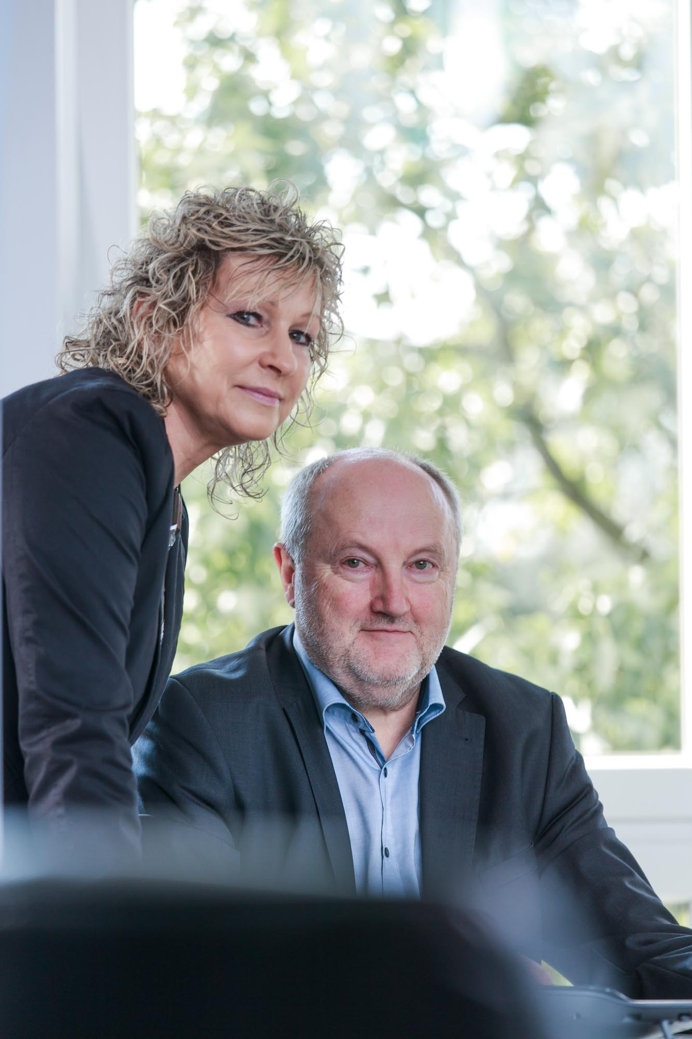
Key data
Family management
Dieter Tappmeyer
(Partner and managing director)
Monika Stephens-Tappmeyer (Managing director)

Slide 11
Key data
Sales development in KK €

Slide 12
Industries and key areas
Sales according to category

Slide 13
Our services
Individual solutions
Franchise Distribution
Engineering Service
Logistics
solutions

Slide 14
Our fields of competence
POWER
MANAGEMENT
SIGNAL
PROCESSING/
MICRO-
CONTROLLERS
OPTO-
ELECTRONIC/
DISPLAYS
MOTION
CONTROL
SENSORS
RF MICROWAVE WIRELESS
STORAGE
NETWORKING/
DATACOM

Slide 15
Topics
MEV at a glance
Quality
Fields of competence
Service
Objectives

Slide 16
The MEV quality management
Certification according to DIN ISO 9001:2015
Certification according to DIN EN 9120:2018
(for suppliers of the aerospace and defense industry)
Maximum efficiency, professionalism and continuous quality assurance

Slide 17
Cost reduction
Up-to-date knowledge
High
product availability
Your
advantages
Product preservation
Permanent supervision of product quality and delivery performance
Comprehensive
product
documentation
Fast
traceability

Slide 18


MEV – certified supplier of the aerospace and defense industry
DIN EN 9120:2018
Comprehensive quality management system for aforementioned supplier
According to statutory provisions of the aviation authorities
Additional requirements and supervision
Extended audits
Entry in the OASIS database (Online Aerospace Supplier Information System)

Slide 19
Increased quality due to greater commitment
Co-authorship of the FBDi Environment & Conformity compass (action guideline for the topics CE, RoHS/RoHS2, WEEE/WEEE2 etc.)
Member of the FBDi (professional association for component distribution)
Actively involved in the Environment and Compliance work group

Slide 20
Topics
MEV at a glance
Quality
Fields of competence
Service
Objectives

Slide 21
Our fields of competence
POWER
MANAGEMENT
according to turnover level in %
SIGNAL
PROCESSING/
MICRO-CONTROLLERS
38,6 %
OPTO-
ELECTRONIC/
DISPLAYS
MOTION
CONTROL
4,6 %
SENSORS
8,2 %
10,2 %
RF MICROWAVE WIRELESS
STORAGE
8,4 %
NETWORKING/
DATACOM
6,4 %
14,2 %
9,4 %

Slide 22

AC/DC Power Supplies
Compact PCI
Power Supplies
DC/DC Converters
Power over
Ethernet
Battery Charger
POWER MANAGEMENT
active
Switching &
Linear Regulator ICs
Current &
Voltage Sensors
Thyristors
MOSFET Gate Drivers &
Optocouplers
Protection Devices
Silicon Carbide
(SiC)
Diodes & Rectifiers
MOSFETs & IGBTs

Slide 23
Relays
Fuses
Heatsinks
Varistors
POWER MANAGEMENT
passive
Capacitors
Thermal Sensors
Transformers
& EMI Chokes
Filters

Slide 24

Stepper Motor Driver ICs
Position &
Angle Sensors
Motion Controller ICs
Motors
MOTION
CONTROL
BLDC ICs
Mechatronic PANdrive
Solutions
DC Motor ICs
BLDC Modules
Interface Controller ICs
Stepper Modules
Power MOSFETs

Slide 25





RF & Microwave
ICs DC to 100 GHz
Antennas
Passives
Coaxial Cables
Clocks & Timing
RF MICROWAVE/
WIRELESS
Connectorized Modules
and Subsystems for
RF & Microwave
Bluetooth Modules
WLAN Modules
and Devices
High Reliability and
Space Products
WLAN SoCs
and RF ICs
IoT Solutions

Slide 26

Ethernet PHYs, Switch &
MAC Controllers
xPON ICs and Network Processors
Real Time Ethernet
xDSL and
G.Fast SoCs
RJ45 Jacks
NETWORKING/
DATACOM
Fiber Optical
Transceivers
for Single and
Multi Mode Fiber
Connectors
(USB, M12, M8, etc.)
Fiber Optical Transceivers
for POF and PCS
Transformers/
Magnetics
Industrial Interface
Controllers & Transceivers
Ethernet Interface
Modules
PoE Midspans
& Switches

Slide 27

Consumer Grade
SSDs
SATA SSDs
PCIe
USB to SATA/
PCIe Bridges
PATA SSDs
Card Reader
Controllers
STORAGE
CFast Cards
Memory Modules
and ICs
Compact
Flash Cards
Disc Chips SSDs
SD Cards
DRAM Modules
Micro
SD Cards
USB
Modules

Slide 28

SENSORS
Pressure
Sensors
Vibration Sensors
Optical Sensors
Piezo Sensors
Analog Front Ends
Position &
Angle Sensors
Humidity Sensors
Sensors
Force Sensors
Water Level Sensors
Flow Switches
Liquid Level Switches
Current & Voltage Sensors
Magnetic Switches
RF Components
for RADAR Sensors
Temperature Sensors

Slide 29

Monochrome
LCD Technology
(TN, STN, FSTN, ASTN, VTN, FSC)
Optocouplers
E-Paper Displays
Fiber Optical
Transceivers for Single
and Multi Mode Fiber
OLED Displays
Fiber Optical
Transceivers for
POF and PCS
OPTOELECTRONICS/ DISPLAYS
Customized
Display Solutions
Industrial
TFT Displays
Optical Sensors
Touch Screen Solutions
(resistive + capacitive)
LEDs for Indication,
Light Pipes, LED Mounts
and Assemblies
LED Drivers
UV LEDs,
Infra Red LEDs
LEDs for Lighting
(High Power LED Emitters
and COB Products)

Slide 30

MCUs & MPUs
Filters
Audio ICs and Codecs
SIGNAL PROCESSING/
MICROCONTROLLERS
Crystal & Oscillators
Operational
Amplifiers
Data Converters
Analog Front Ends

Slide 31

Our partnerships:
Much more than manufacturers of electronic components
Confidence is the basis of our cooperation with international manufacturers.
For our customers, this means:
Open and honest advice.
And conditions that match in terms of time, costs and logistics.

Slide 32
Topics
MEV at a glance
Quality
Fields of competence
Service
Objectives

Slide 33

SUPPORTING
YOUR
VISIONS
Our service promise:

Slide 34
Sales & Marketing Structure
Sales
Marketing
10 Regional Field Sales Engineers
12 Inside Sales
11 Product Line Managers & Field Application Engineers
Responsible for the customers
Responsible for the products & suppliers
Strong focus on demand creation & design-in

Slide 35

FAE project consultancy:
We find the better solution!
That abbreviates your development cycles.
That increases your degree of innovation.
That relieves your development teams.

Slide 36

Laboratory support:
We save your time!
Our laboratory supports you in technical issues by
Prototype construction
Preparation of circuit diagrams
That
provides your development teams with more freedom.
High-power applications
Layout
Low-power applications
EMC measurements and analyses
Notes:
On the bottom left low-power applications

Slide 37

Logistics solutions:
We make it easy for you!
Parts management
(C-parts, missing parts, non-standard parts)
Automated warehouse concepts
(customized)
Packaging solutions
(Dry Packs, Nitrogen protective gas)

Slide 38
Topics
MEV at a glance
Quality
Fields of competence
Service
Objectives

Slide 39




What we will achieve by 2025
Preservation of the position as "Top Demand Creating Distributor" in Central Europe
Continuous investment in human resources and infrastructure
Maintaining the sales target of > €60 million/year. until 2025
Expansion of the sales areas of Austria, Switzerland, Eastern Europe, Benelux
Expansion of customer base

Slide 40


